Slide 1

Belonging in Bolton
Inclusive Practice

Slide 2
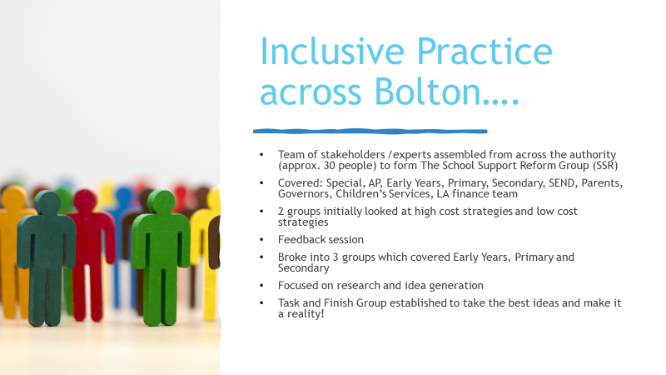

Slide 3
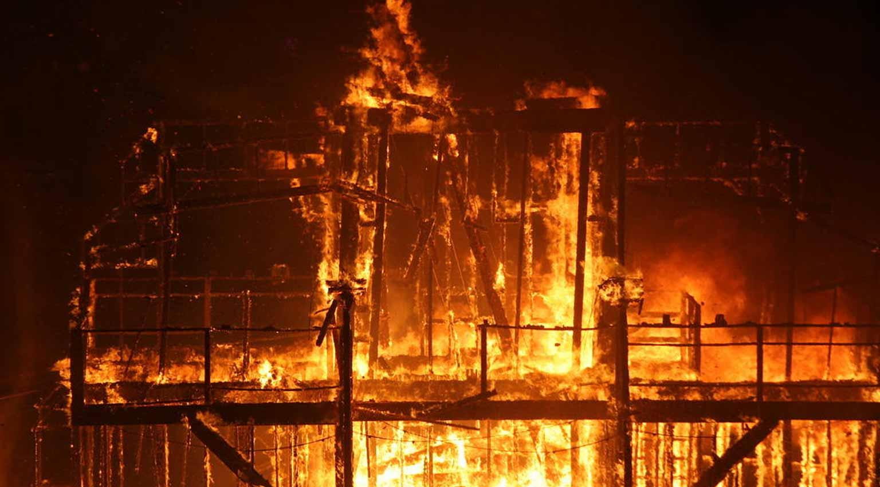
The Burning Platform
Permanent exclusion rates were among the highest in the country
Huge financial pressures on high needs block
Outcomes for children in Bolton were below national average at KS4

Slide 4
What did we focus on?
Designing a framework to support school leaders to enhance inclusive practice IN THEIR SCHOOL by:
Concentrating on leadership of school culture
Providing training for all staff
Giving leaders a Self - Evaluation and review framework to identify strengths and areas to improve
Giving school leaders a guidance framework to support best and next practice
Creating a self managing, peer to peer accountability system

Slide 5






An Inclusive Practice Handbook
A guide for school leaders and governors
Provides the detail on each stage of the strategy
Develops consistent approaches
A tool to support and challenge
Signposts where to go and what to do

Slide 6
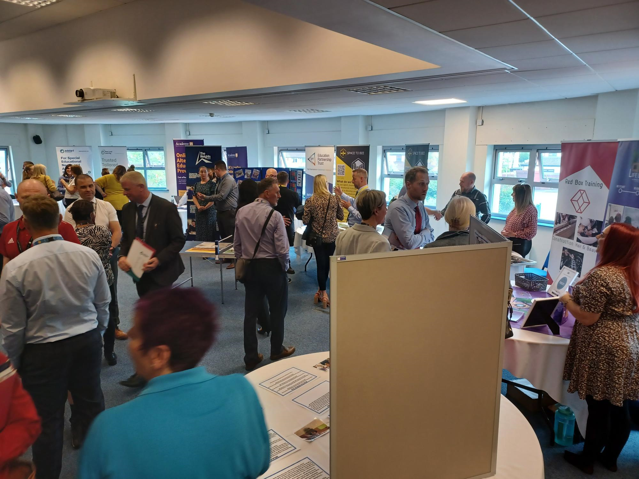


AP Handbook
Alternative Provision Details
October 2022
Inclusive Education and SEND Training Program
Understanding trauma and trauma informed approaches for SENCOs, teachers and TAs
Behaviour and Inclusion Partnerships

Slide 7
Commissioning of AP
Started to use the Dynamic Purchasing System (DPS) in September 2019 – Window to invite further providers took place 2022.
Initially a 2 year contract with 2 x 12 month extensions – ending 31st August 2023.
Undergone a full procurement exercise to re-tender services and update the framework for September 2023.
Rationale was about increasing the range of provision to ensure a more diverse offer to meets the needs of individual young people.
Local Alternative Provision Framework (DPS) – 6 lots

Slide 8
Quality Assurance: Alternative Provision Pathway
CQMO Identified to Undertake Monitoring and Quality Assurance
CQMO to Check Internal Documents
CQMO to Conduct Initial Risk Assessment of Providers.
CQMO to Arrange Introduction Meeting with Provider.
CQMO to Complete Relevant Monitoring Visit.
CQMO to Monitor Improvement Plan.
CQMO to prioritise unregulated provision over regulated.
Check QMC-5 monthly data return documents are complete and up to date.
Review of regulation inspections.
Enquiries with key professionals (Social Workers / IRO / Inclusion Team / Safeguarding / SENDAS)
To email/phone call provider Head/Lead with a view to conduct an introduction meeting.
Virtual/Physical dependent on location.
QMC-1 Manager/Lead discussion
QMC-2 (Ad-Hoc) Response to a complaint / safeguarding concern /Downgrade of Regulation rating.
QMC-4 Full Audit
CQMO to regularly monitor and update improvement plans.
CQMO to ensure key leaders are kept up to date with assurances of provider quality.

Slide 9
QA visit types
Ref. | Standard QA Activity Type | Minimum frequency
QMC-1 | Quality and Contract Monitoring Meeting | Annual
QMC-2 | Quality and Safety Assurance Visit | Ad-hoc
QMC-4 | SEND Education and AP Annual Self Evaluation Form | Annual
QMC-5 | Dashboard Data Return | Monthly
QMC-9B | SEND Education and AP Annual Validation Visit | Annual

Slide 10


