Slide 1

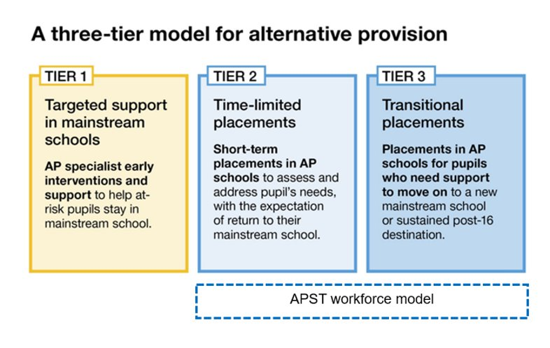
  3 tier model for Alternative Provision
Improvement Plan commitment: An alternative provision system that is fully integrated with the wider SEND&AP system, where alternative provision is an intervention, not a destination, using a 3-tier model
What are we testing during the Change Programme?
Strategic planning for the commissioning and delivery of alternative provision through their Local Area Inclusion Plan (LAIP). Plans based on 3-tier model outlined in the SEND&AP Improvement Plan, including the AP Specialist Taskforces workforce model. Changing the way that AP is funded, to break the link between funding and AP placements.
1

Slide 2













  AP Specialist Taskforces (APST)
The work of the taskforce makes a huge difference for pupils. Experts in speech and language, mental health, youth justice and youth working form a highly effective and efficient partnership. They quickly identify the specific needs of pupils. They help pupils and their families to understand why pupils might have found things difficult in the past. Pupils get the right support to be successful.
Ofsted report of a pilot school
APST is a workforce model designed to build the capacity and skills in AP, and is a key enabler of AP reforms and the 3-tier model.
It involves;
Multi-disciplinary teams of specialists;​
Co-located in an alternative provision school; ​
Building trusted relationships and providing rapid support to pupils​
The DfE has been testing this model since 2021 in 22 AP schools in England.
An independent evaluation is ongoing (reporting 2025) but DfE collected metrics, engagement and case studies to date show early positive indications for pupil outcomes.​ It is also thought to be improving the skills and development of staff who work alongside a taskforce, and changing the role APs play in their local system.
Key principles of the APST model
The APST model draws on the best available evidence and has the following core components:
Location in AP schools, where pupils have some of the most acute need and for whom traditional referral services are likely to be less appropriate.
Co-located teams which share their specialist knowledge to provide co-ordinated support rooted in a holistic understanding of children’s lives.
On-site presence which enables specialists to better understand young people’s needs and build trusting relationships, with the aim of improving engagement.
Specialists can be responsive to young people’s needs in a more timely manner rather than waiting for lengthy referrals.
Specialists and APs are brought together to improve coordination and strategic collaboration with each other, and with local agencies and schools.
Example taskforce
Educational
Psychologist
Mental health therapist
Speech and language therapist
Taskforce Manager
Leading a team of at least 4 different specialists
Youth justice worker
Post-16 transition coach
Social worker or Family support worker
Youth worker

