Slide 1
Bridge Conference 2024
Trauma Informed and Attachment Aware
Notes:
11am

Slide 2
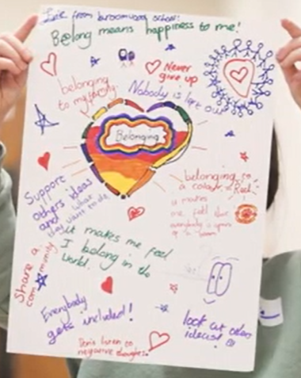
We have mixed everyone up on tables so that you are sitting with people who have different roles to you and who you might not have met before.
Today is all about building bridges so please take this opportunity to get to know each other and share what you want to get out of today by following the Slido link below:
Welcome to the Bridge Conference
slido.com with #1218552

Slide 3
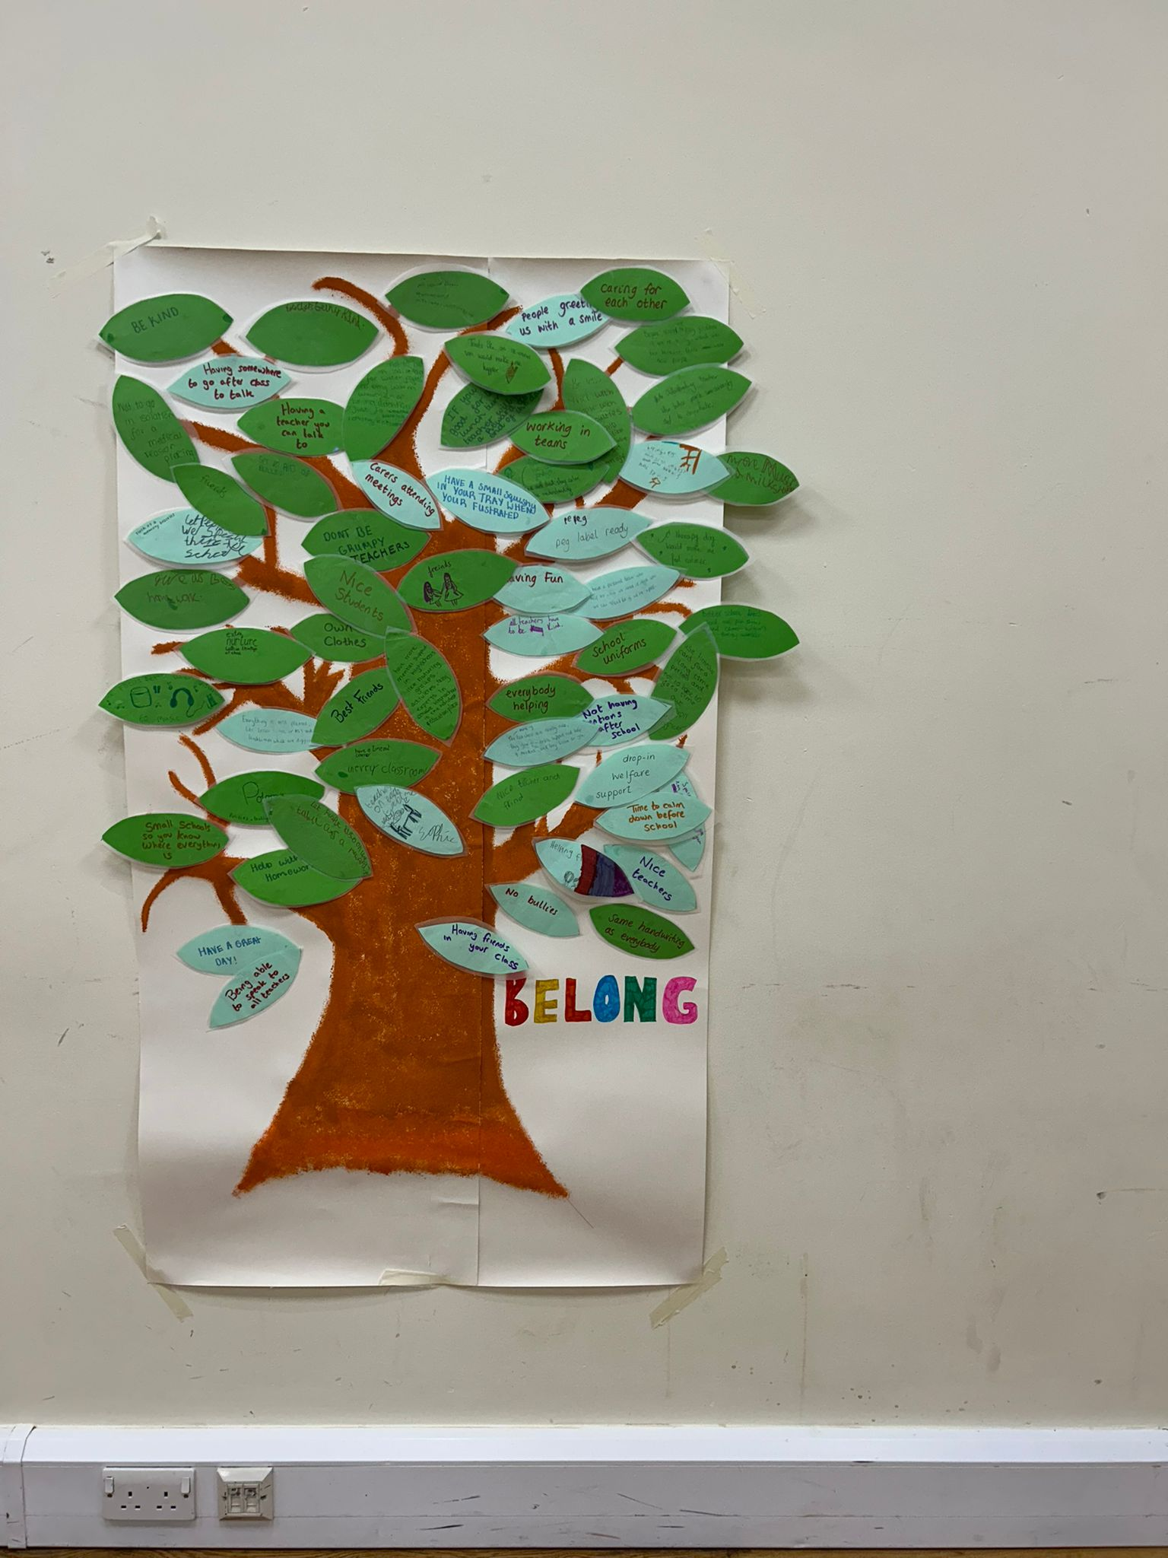
What do we want to achieve today?
To bring people from education, social care and partner agencies together to find out more about how to work in a more trauma informed and attachment aware way
To understand the research behind trauma informed and attachment aware practice and to learn about strategies to work in a more trauma informed and attachment aware way
To understand how trauma informed and attachment aware practices fit into the education and social care landscape of Trafford
To raise awareness of the support available through Virtual School for those working with children who have had a Social Worker and to learn about the Belong Programme
To learn from schools about how they have developed trauma informed and attachment aware practices
To hear the voices of children about what ‘belong’ means to them
Notes:
9:30

Slide 4
Bridge Conference 2024
8:30 Breakfast and Marketplace
9:30 Jill McGregor, Director of Children’s Services
9:45 Keynote Speech - Dr Janet Rose
10:45 Break
11:15 Lynsey Burridge, Virtual School Head
11:30 Karen Samples, Director Education Standards, Quality and Performance
11:45 Question & Answer Panel
12:15 Table discussion
12:45 Belong Children’s Group
1pm Lunch and Marketplace
2pm Best Practice workshops delivered by Belong Cohort 1 schools
3:30 Closing Remarks

Slide 5
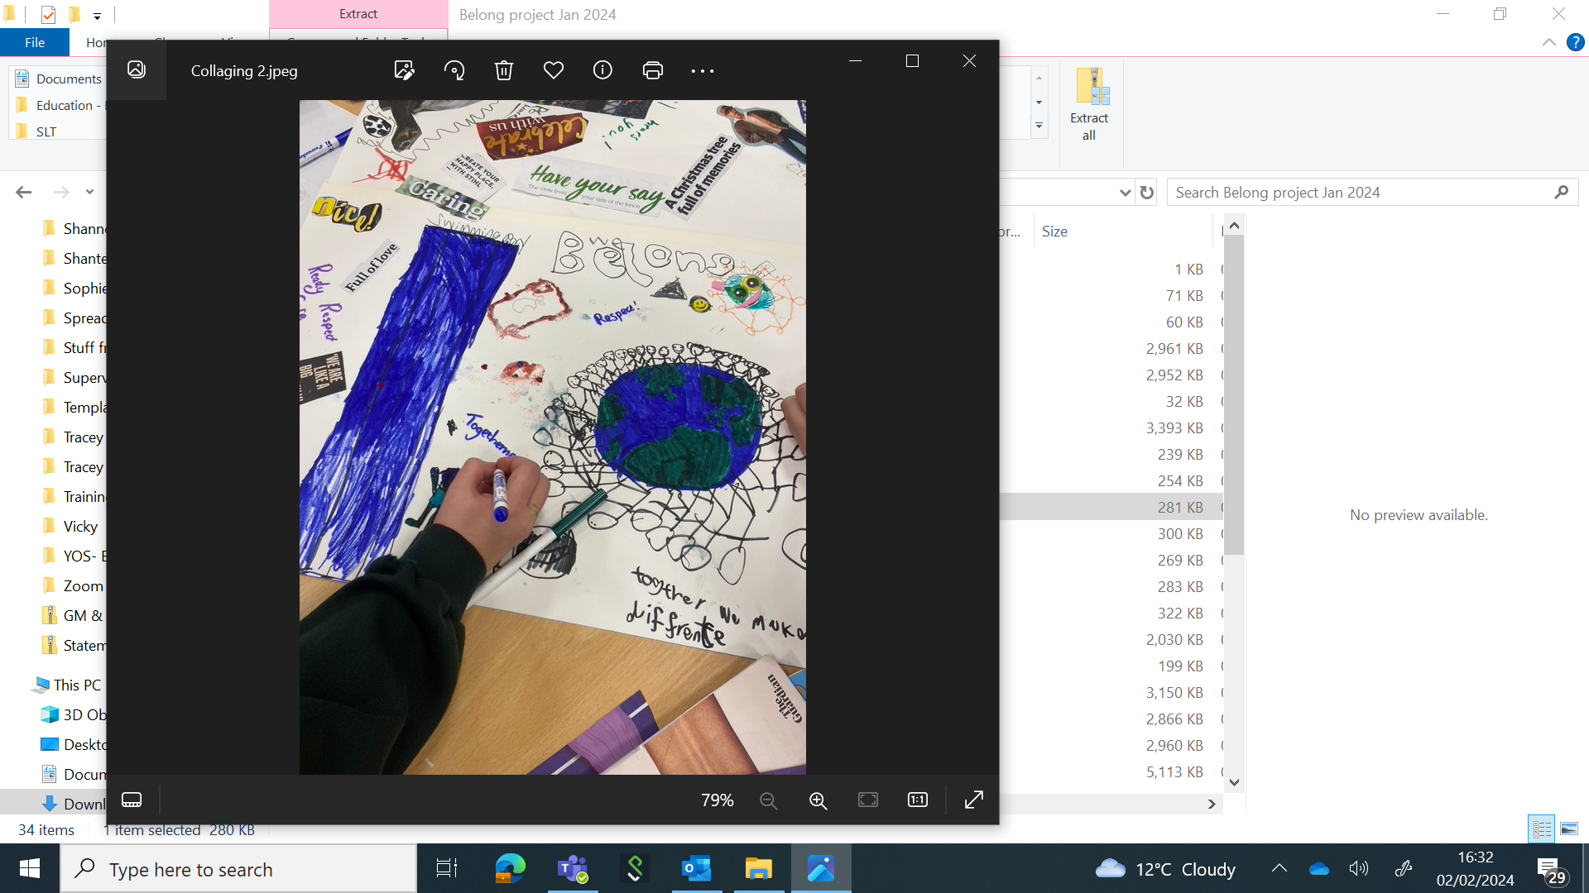
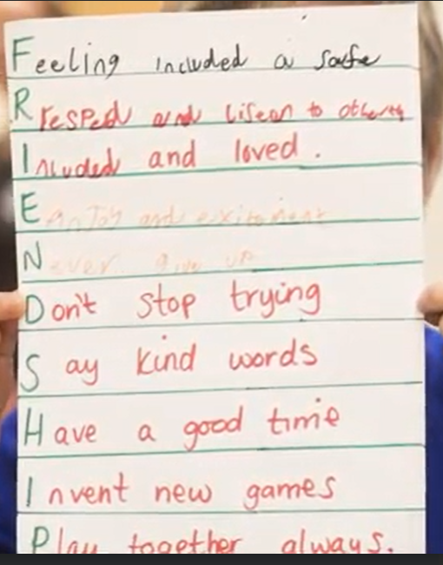
Jill McGregor
Director of Children’s Services

Slide 6
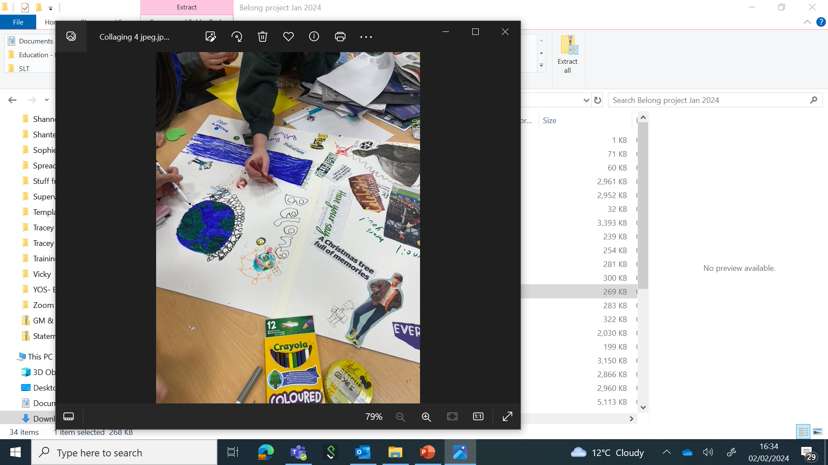
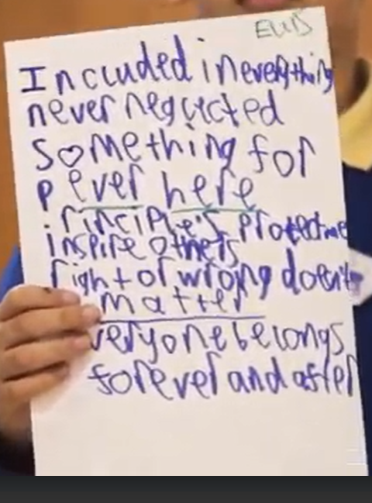
Keynote Speech
Dr Janet Rose

Slide 7
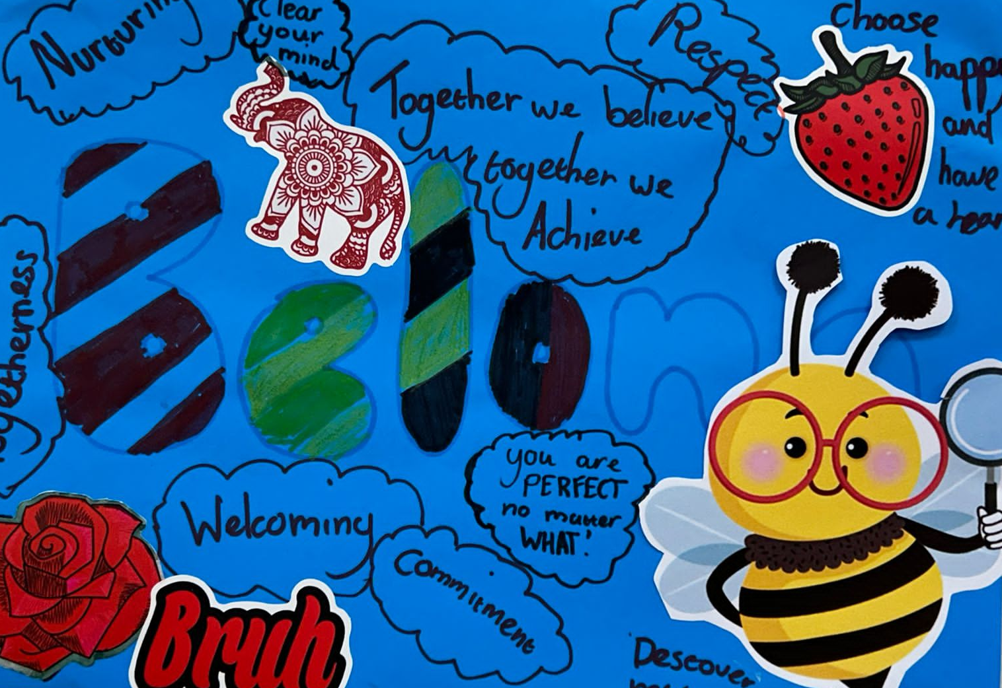
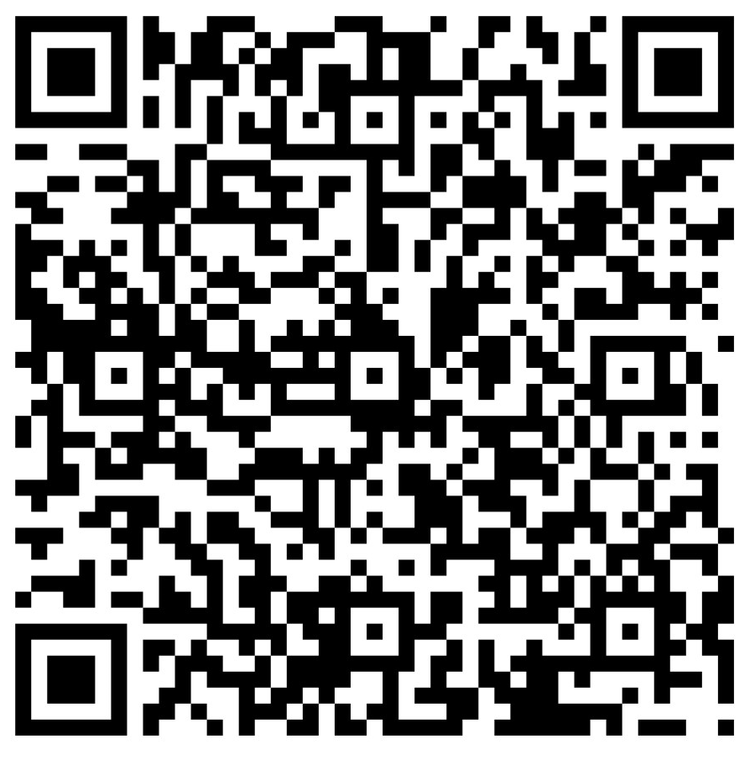
Break
Submit your question for the Q&A Panel

Slide 8
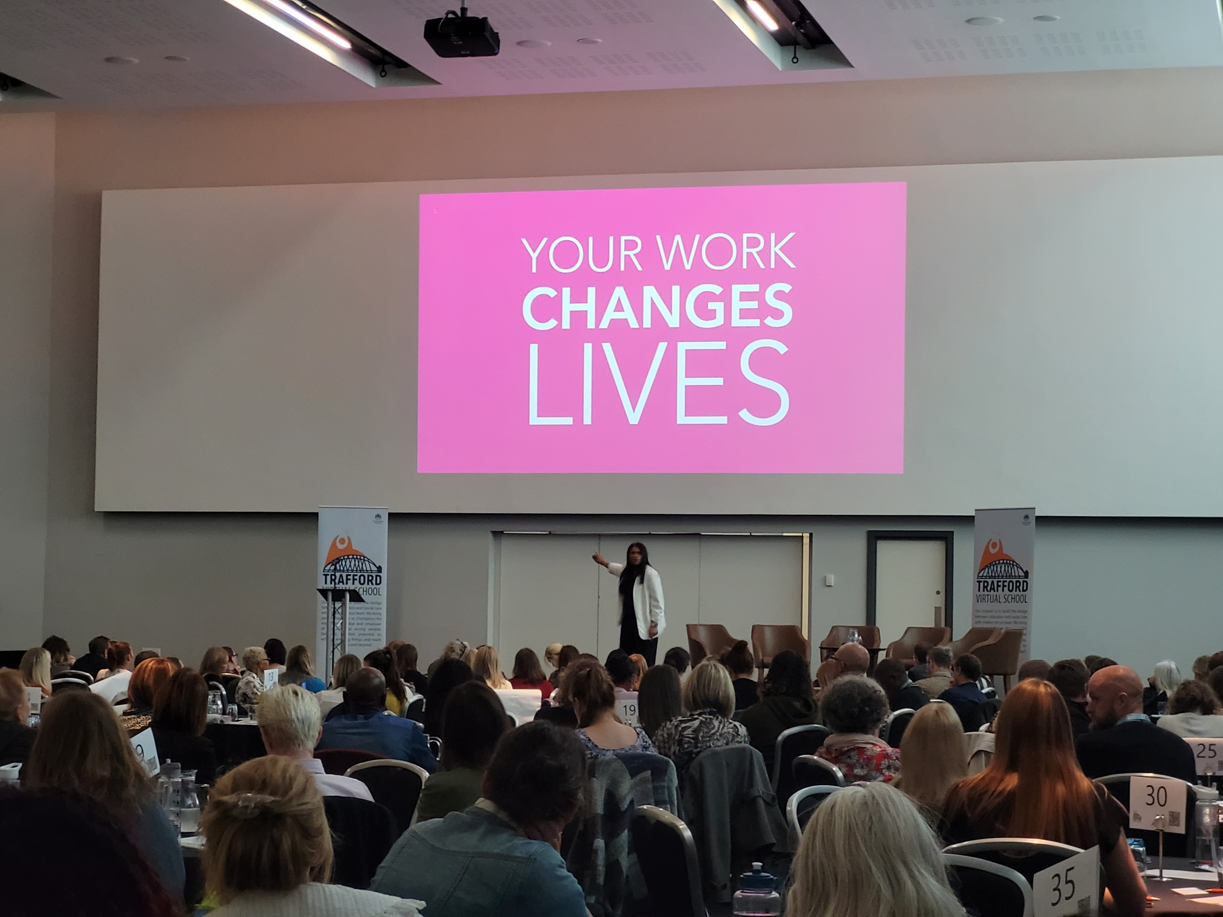
Our Mission
“Despite the challenges that children with a social worker face, with the right support, the aspirations of these children can be raised, and they can go on to achieve more than their peers. It is crucial that those supporting children with a social worker have the vision, awareness, and the right tools to enable these children and young people to achieve their best and ensure there is equal access to education opportunities” (Department for Education, 2022)
Our mission is to build the bridge between education and social care with children at our heart. We bring people together as champions for education to value and empower all children and young people, believing in their potential to achieve amazing things and reach for the stars and beyond
Notes:
The purpose of Virtual School is to be the bridge – bringing people together – like today and like psychological consultations, Belong

Slide 9
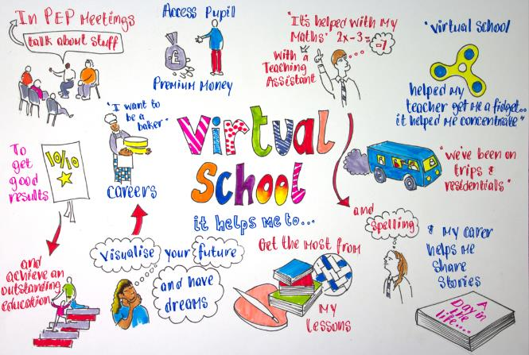
These groups of children face significant barriers to education because of their experience of adversity and trauma. Most commonly abuse and neglect.
Looked After Children are those in the care of their local authority, which is sometimes referred to as a 'corporate parent'. There are many reasons children may become looked after,
they face abuse or neglect at home
they have disabilities that require special care
they are unaccompanied minors seeking asylum
Previously Looked After children are those who immediately after being in care became subject to an Adoption Order, Child Arrangement Order or Special Guardianship Order.
Children in Need are children, from 0 to 18 years old, who were assessed as needing a social worker in the past 6 years due to safeguarding and/or welfare reasons. This includes all those subject to a Child in Need plan or a Child Protection plan in all education settings.

Slide 10
Looked After Children 378
Previously Looked After Children
71
Children in Need
6000+
Notes:
Last year we asked you to get in touch – you did! Thank you!

Slide 11

How can we help?
THE LOOKED AFTER CHILDREN OFFER
Information, advice and guidance for schools, social workers and families
Support with Personal Education Plans (PEPs) and attendance at meetings as appropriate
Daily attendance monitoring and follow-up
Oversight and allocation of Pupil Premium Grant funding
Educational Psychology consultation and priority access to assessment
Speech and Language Therapy consultation and priority access to assessment and intervention
Enhanced careers advice offer
Access to educational opportunities such as university visits and work experience
Access to mentors, tutors, TA support and counsellors through the Alternative Provision Framework
Access to a Play Therapist and wellbeing support
PREVIOUSLY LOOKED AFTER CHILDREN
Children and young people in the care of the Local Authority which acts as their Corporate Parent
CHILDREN IN NEED
Children and young people who have an
Adoption Order, Special Guardianship order or Child Arrangement Order
Children and young people who have a Child in Need Plan or a Child Protection Plan, or had one in the last 6 years
LOOKED AFTER CHILDREN
THE PREVIOUSLY LOOKED AFTER CHILDREN AND THE CHILDREN IN NEED OFFER
Information, advice and guidance for schools, social workers and families
Support to access available funding such as Pupil Premium Plus and Adoption Support Fund (Previously Looked After Children)
Training opportunities to develop an understanding of trauma informed and attachment aware practice
Psychological consultation with a Clinical Psychologist to gain a shared, holistic understanding of a young person’s strengths and needs
Educational Psychology consultation
Support to analyse data and set strategy
Model education plan and support to implement this

Slide 12





Two Year Programme
Post- Graduate Study and Action Research
To establish common purpose and catalyse change
A clear school Audit and Development Plan
To underpin the work
Inter-school Networks
To share learning and innovative practice
Reflective Practice Supervision
Whole School Training
Including Senior Leaders and Support Staff
Co-produced Model Relational Policy Framework

Slide 13
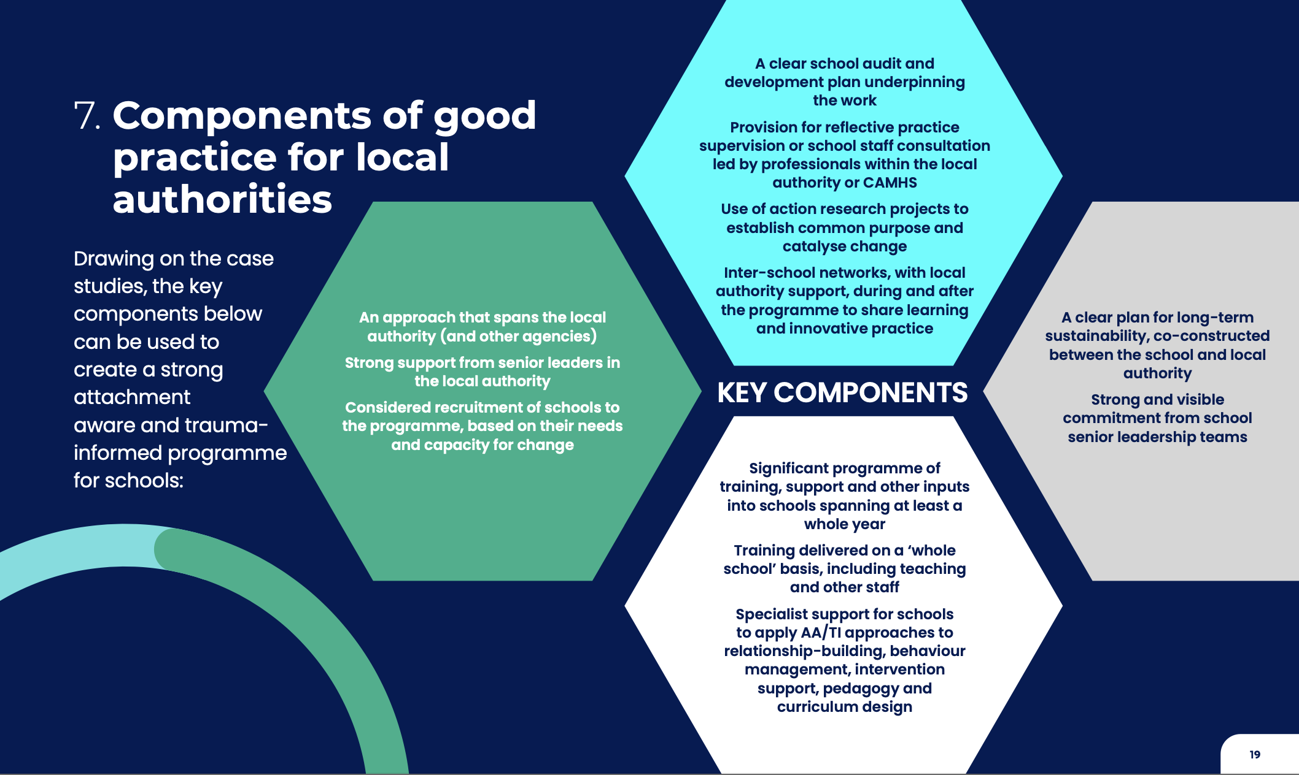
Belong is based on national best practice research
Notes:
A reminder of our research evidence based theory of change
Local Authority wide approach

Slide 14
Cohort 1
Stretford High School
Wellington School
Heyes Lane Primary School
Broomwood Primary School
St. Hilda’s CE Primary School
Delamere School
Longford Park School
Cohort 2
Trafford College
Blessed Thomas Holford Catholic College
St Anthonys Roman Catholic School
St Matthews CE Primary School
Tyntesfield Primary School
Davyhulme Primary School
English Martyrs Primary School
Holy Family Catholic Primary School
Kingsway Primary School
Stamford Park Primary School
All Saints’ Catholic Primary School
Cohort 3…

Slide 15
Whilst it's challenging, and not the easiest option- it's the right option!
Seeing the behaviour as a form of communication and understanding that relationships are key is crucial. The role of the teacher has to change.
As this is becoming more embedded, we are seeing...
Children who are empowered to express their emotions in a safe way and staff who are better equipped to understand and manage need.
Children are more willing and ready to learn knowing that they are able to proactively reset when dysregulated.
Louise Owen – Broomwood Primary School

Slide 16
We were delighted when the Belong project fell into our lap.
Thanks to some research by two of our senior leaders, we were already dipping our collective toe into the attachment and trauma waters and the project was exactly what we needed to crystallise and give more structure to our thinking.
Ultimately, this approach is nothing new to most of us working with young people but rather an extension, enhancement, and cementing of the values and practices we have lived by for a number of years. It is, after all, very much a common-sense approach. I would also add that it is not about lowering expectations nor 'going soft', as some on social media have suggested; it is about caring enough to get to know and understand your students on a deeper level and apply a 'logical response' to any issues and concerns.
One size doesn't fit all and rigid behaviour policies may work for the vast majority but certainly don't benefit that minority that needs us most. We need to give it time for our approach to embed (we have said 18 months) but the ‘early’ signs are just what we hoped for; you can see and hear first-hand interactions being framed differently and invariably more positively than ever. Still got a way to go so watch this space!
Stuart Beeley – Wellington School

Slide 17
The Porcupines!
All human beings are porcupines - we are cute and lovely until we feel unsafe and then it is spines out - and those spines can be sharp! As a school, we have been honing our ability to be aware of the trauma our children carry.
We're trying to understand what makes our children feel unsafe and why they are porcupining. This lens changes what we previously saw as an unacceptable choice to an understandable and natural reaction and our response is naturally different. This in itself changes relationships - conflict is replaced with connection and this is building a more trusting environment. The decisions we are making are different and the kids can see that.
We are still holding the bar high - behaviours are explained, not excused. But now we are focusing on supporting our children to understand their own behaviours and to regulate - we are seeing this impact on the mental health and wellbeing of students in our soft metrics and even in harder measures such as attendance. Best of all, our kids are porcupining less and so are our adults!
Nicola Doward – Stretford High School

Slide 18
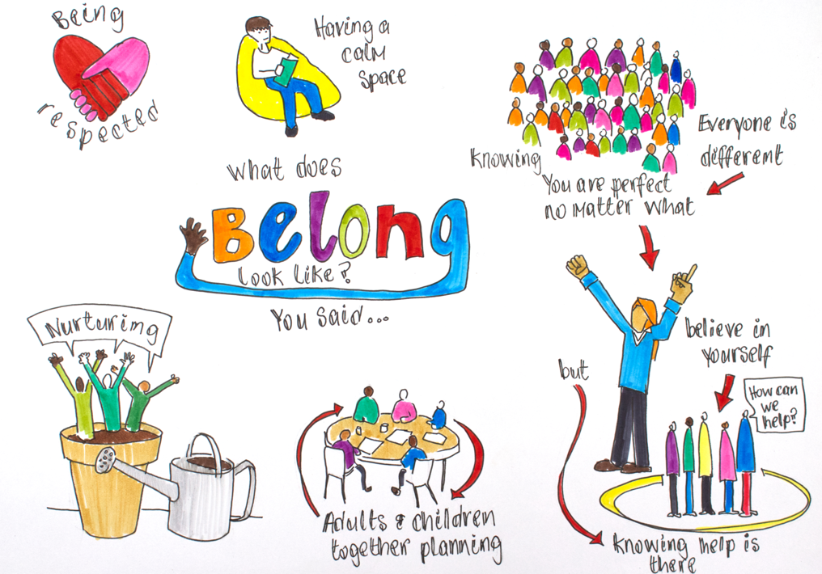

Slide 19
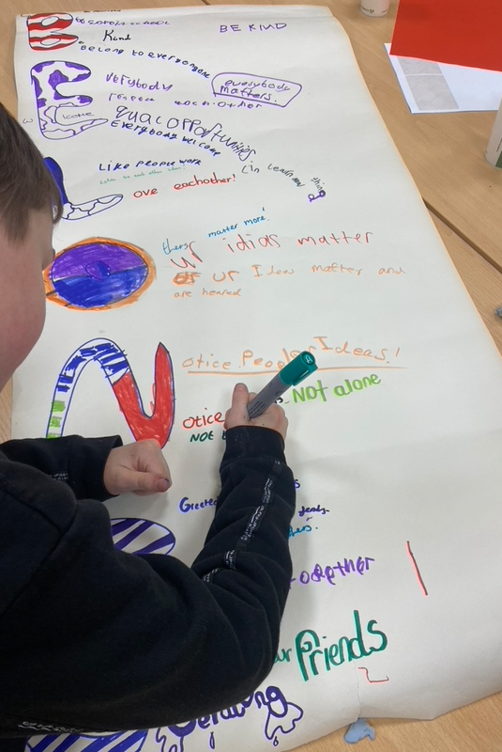
What can you do?
Consider how you might be more trauma informed and attachment aware in your role and in your setting
Put your Virtual School offer sheet on your notice board and share the Education Champions Guide with others who support our children
Consider whether you would like your school or a school you are working with to be part of Belong cohort 3
Consider whether your agency would like to be involved in Belong through our multi-agency steering group
Invite me along to team meetings to spread the word
Keep in touch!

Slide 20
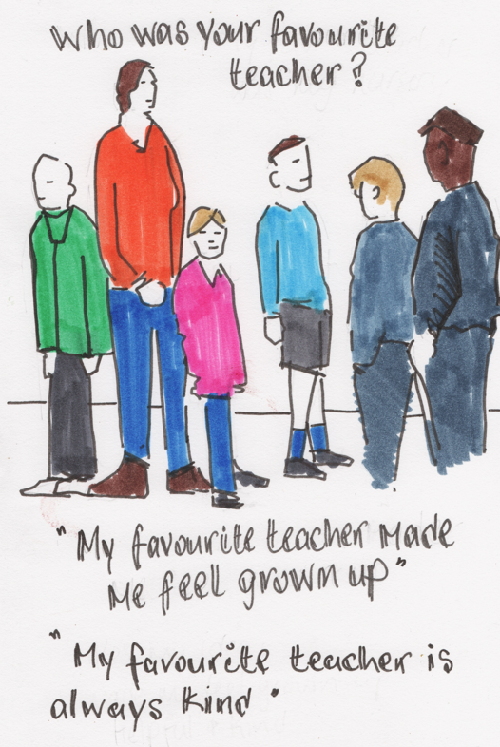
Karen Samples
Director Education Standards, Quality and Performance

Slide 21

Inclusive Trafford

Slide 22
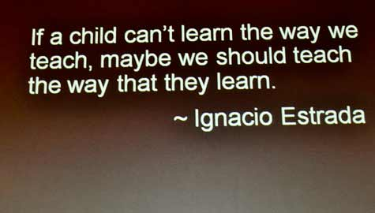

Slide 23


Slide 24

Trafford as a Selective Authority & Inclusive Authority
43,622 CHILDREN |  | 90 SCHOOLS
63 PRIMARY SCHOOLS | 19 SECONDARY SCHOOLS | 7 SPECIAL SCHOOLS | 1 PRU/MES
Trafford is a complex mix of schools within a relatively small borough. 37% (7) of secondary schools are grammar schools with a further 2 being single-sex schools. There are 10 Trusts in existence and 8 stand-alone academies.
93% of primary schools are G/O | 89% of secondary schools are G/O | 100% of special schools are G/O | 94.4% of schools overall are G/O
Local Provision – having confidence that local schools are committed to meeting the needs of children in their local community
Outcomes - keeping them child centred, measurable and tangible
Communication – regular, clear
Accountability – everyone has a part to play, we are all accountable and responsible for supporting inclusion in Trafford
Language – being mindful of how we use language to include, describe and involve all

Slide 25
Trafford Inclusion Charter
Everyone takes responsibility for inclusion
Work with families, professionals and practitioners across our community to help all children and young people to thrive
School culture: the way we do things around here
Clear, visible and strong leadership for inclusion
Child and parent voice is at the heart
Provide a sense of belonging

Slide 26
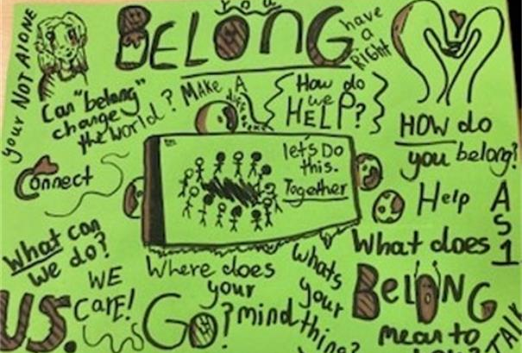
Question and Answer Panel

Slide 27
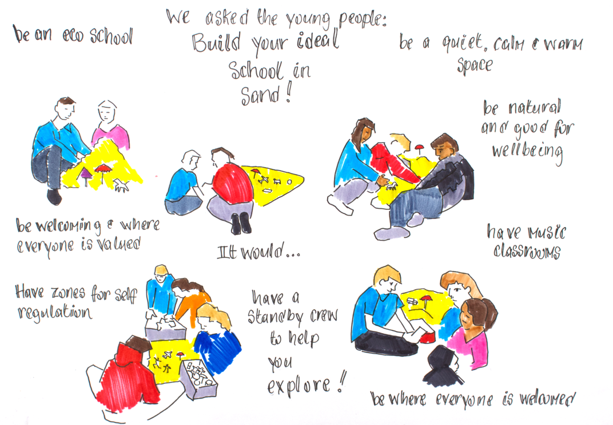
Table Discussions
How do Attachment Aware and Trauma Informed approaches impact your work?
What is one thing you can do in your role to be more Attachment Aware and Trauma Informed?
slido.com with #1218552
Notes:
Switch to slido after 20min

Slide 28
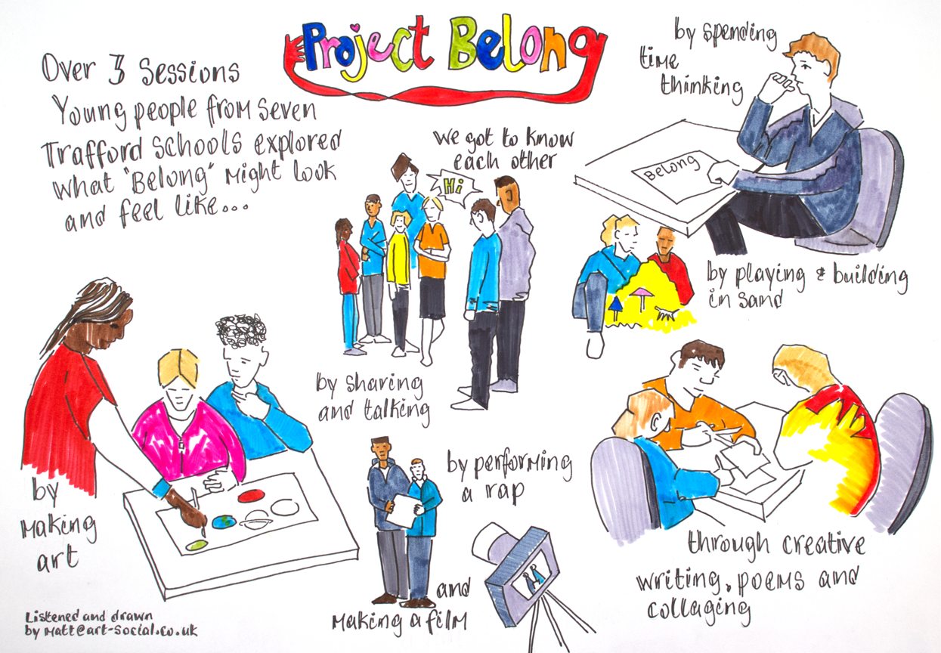
Belong Children’s Reference Group
India
Thomas
Neo
Ellis
Cameron

Slide 29
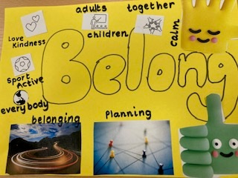
Lunch

Slide 30
Belong Workshops
Workshop 1 - The Muller Room
Implementing a relational behaviour policy by Wellington School
Workshop 2 - The Wilforce Room
Family Engagement by St Hilda’s Primary School
Workshop 3 - The Main Conference Room
Who is listening to me? The power of the voice of the child by Virtual School
Workshop 4 - The Graham Room
Understanding and Communicating Children’s Needs – A Practical Approach by Broomwood Primary and Heyes Lane Primary
Workshop 5 - The Main Conference Room
Supporting the supporters – A multi-agency approach to thinking psychologically about children’s needs by Changing Minds
Workshop 6 - The Luther King Room
Care Curriculum - How do children’s knowledge and understanding of their identity help to develop and maintain good mental health and wellbeing? by Stretford High School

Slide 31
What do we want to achieve today?
To bring people from education, social care and partner agencies together to find out more about how to work in a more trauma informed and attachment aware way
To understand the research behind trauma informed and attachment aware practice and to learn about strategies to work in a more trauma informed and attachment aware way
To understand how trauma informed and attachment aware practices fit into the education and social care landscape of Trafford
To raise awareness of the support available through Virtual School for those working with children who have had a Social Worker and to learn about the Belong Programme
To learn from schools about how they have developed trauma informed and attachment aware practices
To hear the voices of children about what ‘belong’ means to them
Notes:
9:30

Slide 32
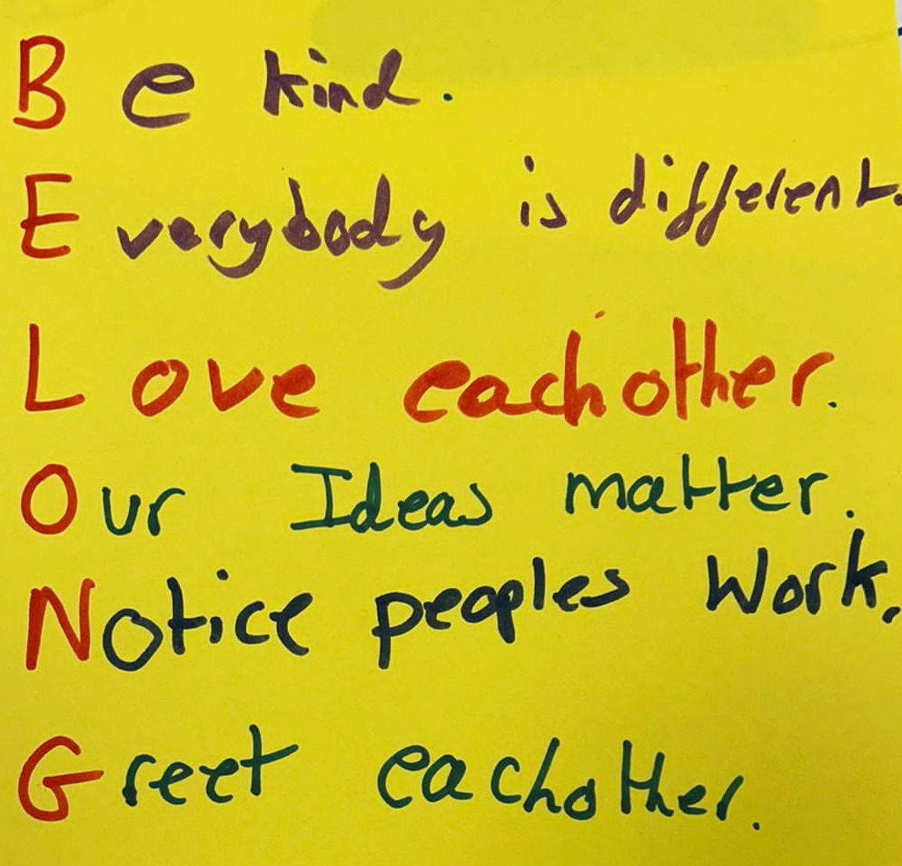
What are your takeaways?
slido.com with #1218552

Slide 33
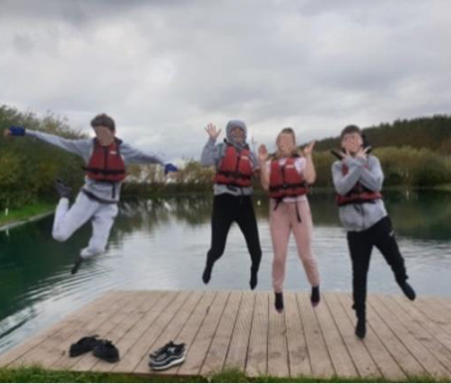
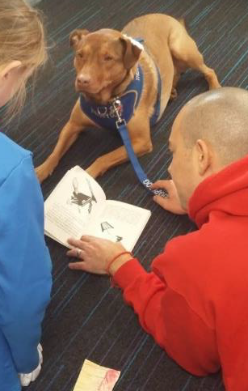
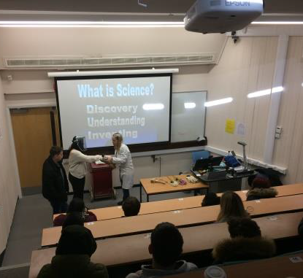
Any questions?
www.traffordvirtualschool.co.uk
@TraffordVS

