Slide 1

Wirral Ketamine Programme
2023 - 2025

Slide 2
2022-23 - EARLY WARNING SIGNS
Increasing Ketamine use known to Response(Young People’s Service)
Increasing Ketamine encountered at Wirral Ways, and Birchwood(IPD)
Ketamine use being picked up in Schools
Ketamine use encountered by Merseyside Police

Slide 3
Wirral Ketamine Response Coordination Report: Context
Agencies that form the Ketamine Response working group include:
Kaleidoscope @ Birchwood – Rehabilitation & Detoxification
Local Authority Children’s Services
Merseyside Police
Public Health England
Public Health Wirral – Addictions commissioning team
Public Health Wirral – CYP commissioning team
Response Drug and Alcohol Service – Young Peoples Drug Services
Wirral Community Health and Care NHS Foundation Trust
Wirral University Teaching Hospital
Wirral Ways CGL - Adult Drugs Services
Other services were engaged and consulted as part of the working group’s activities.
Early In 2024, Wirral Combatting Drugs Partnership (CDP) noted a significant increase in the number of young people who were referring to Response, drug and alcohol service for young people, as well as Wirral Ways CGL services for adults, and disclosing substantial Ketamine use. In a short time Ketamine became the second most prevalent drug in young person treatment referrals, and significant physical harms resulting from their ketamine use were noted, compared to other drugs.
Wirral’s Ketamine Response Coordination group was created following proposal at Wirral’s CDP Strategic Group. The scope of the group encompassed work to address Ketamine use by Wirral residents aged 13+.
The group convened partners across Wirral’s Combatting Drugs partnership with treatment, recovery, enforcement and/or early intervention responsibilities and established an action planning framework, the 4P’s. Relevant groups and leads were convened to progress actions under each of these areas.
Work has been taken forward as a partnership, overseen by the Co-ordination group, chaired by Senior Manager from CYP services and deputy chaired PH Principal. The group’s progress was reported to the Wirral Combatting Drugs Partnership, and the Children and Young People Sub-Group.

Slide 4
Situation: Data was limited and Numbers were not huge but service contact and anecdotal feedback were suggesting a rapidly growing drug use affecting a predominantly younger group, and with some serious health harm being encountered.

Slide 5
Beginning of 2024 established the multi-agency Wirral Ketamine Steering group.
This group has led and co-ordinated the Wirral comprehensive response since then.

Slide 6
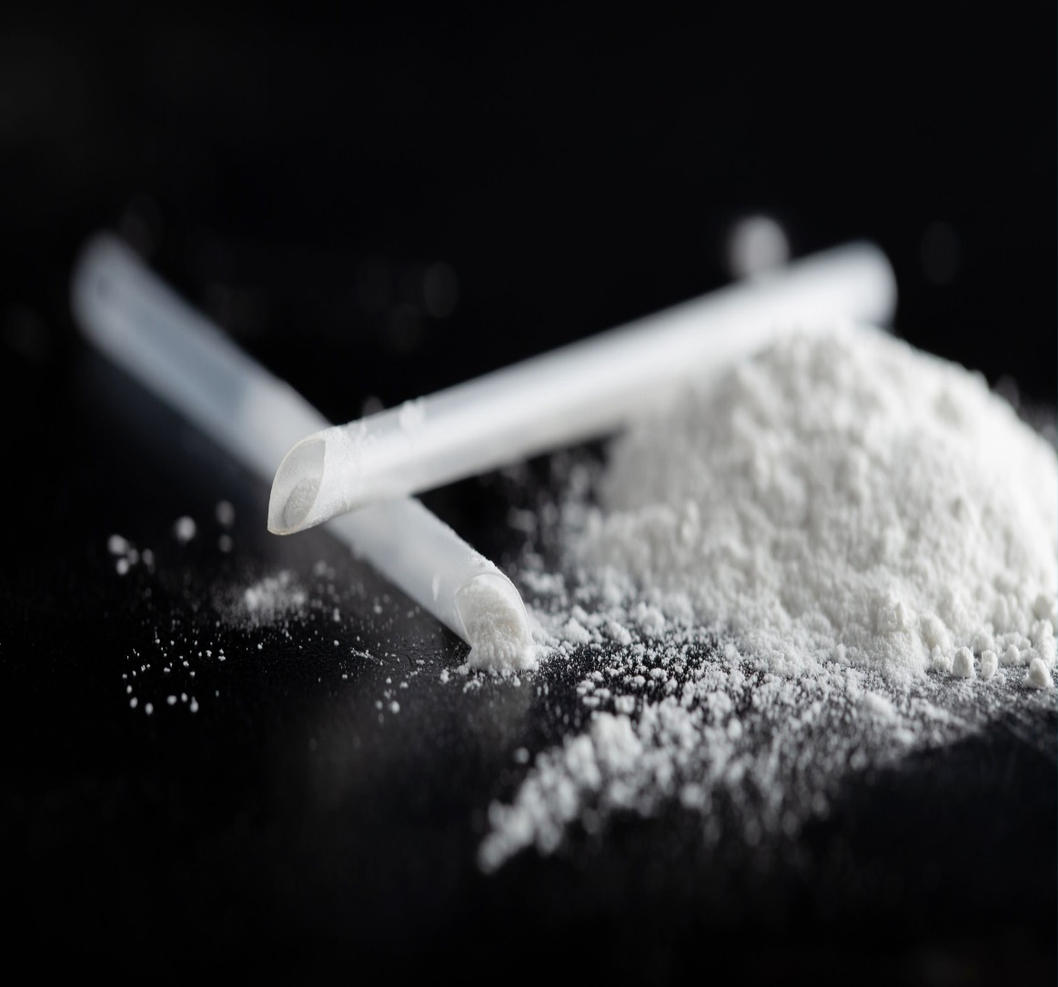
Response
Ketamine

Slide 7
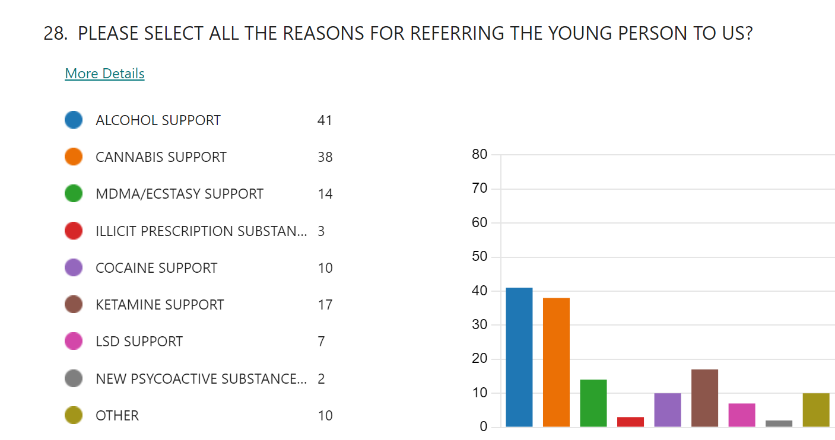
Reasons for Referral 2022/23

Slide 8
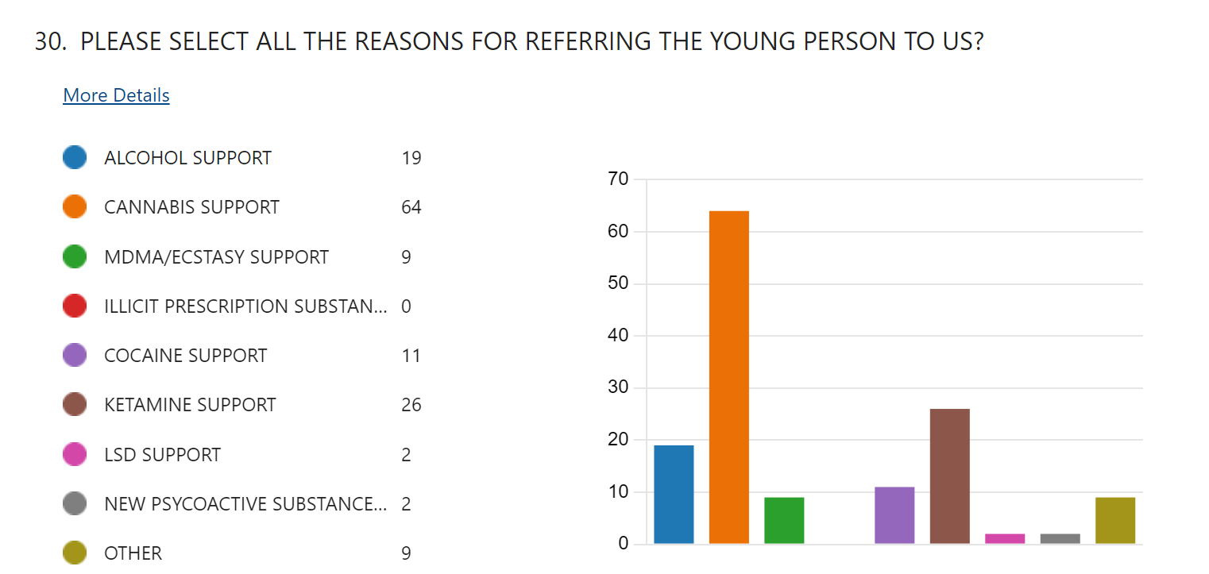
Reasons for Referral 2023/24

Slide 9




 | Age | Postcode | Length of time using | How Often | Symptoms
F | 16 | CH43 | 4 months | Daily almost daily | Cramps Wanting to urinate Blood flesh in urine
M | 15 | CH42 | ? | A&E referral States using Ketamine, with other drugs
F | 16 | CH42 | ? | ? | New Referral (CYD) Housing provider Told SW using Ketamine
M | 16 | CH41 | Regular | Several x wk | Lower abdomen pain
F | 17 | CH44/48 | several months | occasionally | Some discomfort
M | 16 | CH63 | 4 months | Large amounts(2-3g) 6 x month | K hole, very risky behaviour, under the influence
M | 13 | CH44 | Couple of weeks | Used 1-2 times | No ill effects, no regular users in Seacombe/Liscard area
F | 18 | CH63 | months | weekends | Blood in urine
F | 17 | CH44 | Couple of months | Weekends/occasional weekday | Some cramps - hospitalisation
F | 16 | CH41 | 3 months | Once a weekend | none
F | 15 | CH46 | 2 months | 2-3 x week | Excluded for using at school
Signs & Symptoms

Slide 10
They Say!
How easy is to get hold of – “A lot more people “grafting” it than there was a few months ago”
Why Ketamine – “most people i know using it cuz weed ain’t strong enough for them anymore so they moving onto stuff gonna get them more off their face fortheir money”

Slide 11
Findings and Insights
Why Use Ketamine?
Increase in use as a recreational drug/drug of choice – perception change
Barriers to Stopping
Pain management
Impact of Use
Large increase in number of people referred to urology with “ket bladder”
Cheaper than class A drugs
Promoted by dealers
Easily hidden
People accessing treatment after having significant health complications
Vicious cycle of ketamine harms causing pain combined with ketamine's analgesic properties
“Better high”
Dissasociative
Ignorant of physical harms caused by Ketamine
“Safer”
Depression treatment trials
Underlying trauma
Social/environmental
Exploitation
Shame
Perception
Waiting lists
Identification of harms linked to ketamine by professionals
Treatment service challenges – capacity & delivery
Complexity of treatment
Personal care
Ignorance of harms
Social norm

Slide 12
Ketamine – CGL Adult Service Data and Guidance
2023 - 46 Ketamine users in treatment.
2024 – 75 Ketamine users in treatment – aged between 18-24 years old.
Harm Reduction Advice.
If using Ketamine:
Go slow and start low.
Don’t use alone.
Using Ketamine with Cocaine dulls the effect of Ketamine so users can be inclined to take more over a longer period (CK1). Avoid this.
Best Harm Reduction advice – stop using. Regular Ketamine can quicky cause damage to bladder that can be irreversible. Not recommended just to reduce.
If using Ketamine do drink plenty of water.
Recommended Our Courses | Drugs Training Ketamine - risks, rewards, and Safety.

Slide 13
2023-24 – Reports of Use in Schools to Schools Drug Advisor
Young people more aware of the prevalence of Ketamine, ‘normalised’ with those who use or speak about the drug. School staff saying they were encountering more young people openly discussing the drug or disclosing their experiences within the community.
In the previous academic year encountered 3 serious incidents occur in 3 separate schools, involving young people suspected of using Ketamine or being in possession of a white powder / Ketamine.
Outside of school, School Safeguarding Leads being contacted by parent’s with concerns over mson/daughter’s ’s use of a white power / ketamine over the weekend. Some parents finding footage from their child’s mobile phone (Snap Chat), showing them being under the influence of a substance.
Raising concerns about the use of white powders, impact on the school communities, concerns about purity, prevalence, on-line media.
Response: Increasingly raising awareness of concerns about this use of “white powders” / white powders in staff briefings and staff training in schools.

Slide 14
Themes
Lack of awareness among CYP and some professionals of the emotional, and particularly physical harms caused by Ketamine even in a relatively short time with regular use.
CYP using Ketamine as an alternative to more expensive drugs such as cocaine given the low price in comparison.
Often used initially as a “party drug” on nights out, but the sedative effect soon becomes more attractive for many young people, especially those who have experiences of trauma, anxiety or poor mental health.
Ketamine use being increasingly socially normalised, snorting powder is no longer unusual in younger age groups.
Ketamine being used by some CYP as a “stronger” drug, preferred to other drugs such as cannabis.
Concerns about CYP being exploited by gangs, with young people whose use has exceeded their financial situation rewarded with Ketamine.
Concerns about Online supply via social media platforms, easier access can often desensitise users from possible negative side effects.
Contribution to the risks of Drug Driving, given its sedative effect.

Slide 15
Work Plan
Given the widespread community use, and almost universal misunderstanding of the harms associated with Ketamine. We felt as a group that universal Education and Prevention was key. A baseline to work up from.
Everyone involved understood that there needed to be a swift and detailed response to the increase in the use of Ketamine across the Wirral, and the harm that was presenting itself.
The aim was to enable young people and Adults to:
Make more informed decisions about the dangers of regular Ketamine use
Understand what signs to looks for, and how and where to access support if in need of medical advice on the effects of Ketamine
Where to go to for support if they were ready to address and stop their Ketamine use
Ketamine Harms leaflet
Ketamine Awareness Lesson Plan & Materials for Schools (Y10+)
Bespoke Ketamine Sessions for Secondary Schools (Y10+)
Ketamine Spotlight Sessions for Professionals & Education
Screening Tool
LIPA Harms Video
Service developments – Wirral Ways & Response

Slide 16
Early and Ongoing Actions
Despite limited data being available, decisions were made to make a series of strong and sustained harm prevention/reduction actions. Bringing together partner agencies who were front facing and experiencing issues with their client base.
Enhanced comms and engagement programme on the risks of Ketamine (prevention)
A system wide awareness programme raising the understanding of significant risks, symptoms and where to seek help messages
Harm reduction information leaflet designed to target to people using regularly
A specific and consistent training and education programme in schools - Ketamine “Z-cards”
Professionals training and awareness programme for wider workforce, upskilling knowledge and ability to provide interventions.
Improving pathways to, and between, specialist treatment, especially for under 18’s
Work with Merseyside Police – exploitation using ketamine
.

Slide 17


Slide 18
Themes and Actions
.
Continuing/Rising Priorities
Improving pathways to treatment, especially for under 18’s – remains an issue
Improving transition between young people’s services and adult’s services
Increasing engagement with G.P.s
Stronger and more effective links with Acute Health (A&E, Urology)
Work with Merseyside Police to continue enforcement – exploitation using ketamine

