Slide 1




North West Learning and Support Hub
Child and Parental Mental Health Data Lab

Slide 2
Time | Item | Objective/ Outcome
1:00-1:05 | Welcome and Introduction
1:05-1:15 | North West Multi-Agency Safeguarding Dataset | Intro to the regional safeguarding dataset and related guidance documents
1:15-1:40 | Factors that influence the mental health of babies, children and young people Julie Dunning, Health and Wellbeing Manager, Office for Health Improvement and Disparities, DHSC The Spectrum of Mental Health Jo Sampson, Health Improvement Programme Manager (North West), Office for Health Improvement and Disparities, DHSC | Introduction to the government framework, modifiable factors and guidance on Improving the mental health of babies, children and young people. Overview of the spectrum of mental health for safeguarding partnerships to consider how and where to focus attention and data discussion.
1:40 | Breakout 1: Existing data (20 minutes) | What data and insights do we have that could help us better understand and respond to child and parental mental health? Where should be focus our attention and data monitoring-discussions? Please make notes to share in group feedback chat function
2:00 | Group feedback
2:15 | Breakout 2: Gaps (20 minutes) | Where do you see gaps in data and insights to better understand and respond to child and parental mental health? What data and insights could your agency bring to your local safeguarding partnership arrangement, to help fill identified gaps? Please make notes to share in group feedback chat function
2:35 | Group feedback
2:30 | Close – Next Steps | Feedback survey

Slide 3

NW Safeguarding Partnership
North West Children's Safeguarding Partnership MoU | NWADCS
Leading new and innovative approaches in the North West Pilot
Committing to:
Sharing what's working for our children and families
Enabling the sharing to be adopted and build upon in our systems
Collaborating on common challenges/needs, avoid duplication
Examples of outcomes and impact:
NW Multi agency data set
Sub regional and regional safeguarding effectiveness reporting
Child Sexual Abuse NW strategy (4300 participants)
Co production of thresholds tools with children and families
Scoping for system to share NW learning and resources from practice reviews

Slide 4
Sub regional overarching analysis of public health, deprivation, demand on systems to scene set
Commitment 1
Children’s needs are identified early and effectively responded to
Commitment 2
Children are protected from risk of harm
Commitment 3
Children are effectively safeguarded, and their welfare promoted
Commitment 4
Multi-agency partners work together and hold each
other to account
Contacts by agency
Early Help lead professionals by agency
Early Help numbers (Family Help)
Number of children awaiting specialist health assessments/provision (CAMHs)
Child in Need numbers (Family Help)
Referrals by agency
Repeat referrals
Conversion rate contacts to referrals
Strategy meetings/S47/ICPC
Educational Attendance, Exclusions, Electively Home Educated & NEET
Repeat missing from home incidents
CSA and CSE offences
Neglect offences
Child Stop Searches
Child Arrests
Child Strip Searches
Use of Police Powers of Protection
Number of children subject of Child Protection Plans
Repeat CP in two years
Family Group Decision Making offered and held
Number of children subject to Public Law Outline
Initial Health Assessment timeliness
Referrals for practice reviews, serious incident notifications and referring agency
Multi-agency attendance at executive meetings (including education as a strategic partner)
Measure now:
Measure now:
Measure now:
Measure now:
Develop:
Develop:
Develop:
Develop:
Family help plans (care reforms)
Family help needs measures
Mental Health (Child/Parental)
  Extra Familial Harm (CCE/CSE/Online Harm)
  Domestic Abuse
  Neglect
  Serious Youth Violence
Multi-agency child protection team data
How we understand belonging for children
Training delivered
Children seen by partners
Child and parental influence tracker
Voice and experience of children and families- belonging, loving homes and thriving families

Slide 5
Introduction to the government framework, modifiable factors and guidance on Improving the mental health of babies, children and young people.
Julie Dunning
DHSC North West Health Improvement Manager

Slide 6

Fit for the future: 10 Year Health Plan for England
A focus for CYP on early intervention and prevention and to reduce health inequalities to support the governments ambition ‘to have the healthiest generation of children ever’, linking with Opportunity Mission and Best Start in life initiatives
1. Hospital to community: Neighbourhood Health Services work in partnership with family hubs, schools, nurseries and colleges to offer timely support to children, young people and their families including those with Special Educational Needs and Disabilities (SEND) (p.37).
Best Start Family Hubs - bring together children’s services, NHS, and public health with a focus on the critical 1,001 days (p.37).
2. Analogue to digital: NHS APP - My Children, a commitment to the single unique identifier, a 21st century alternative to the red book
3. Sickness to prevention
Ensuring every child has the best start in life is essential to future health and education outcomes (p.37) and join up with the Opportunity Mission focus on early years (p67) Vaccinations by Health Visitors
Increase mental health support teams in schools and colleges, full national coverage by 2029 to 2030
Embedded support for CYPs mental health in new Young Futures Hubs
CYP obesity – emphasises on prevention, early intervention, equitable access to care, systemic and place-based approaches, food policy reforms to improve public health outcomes
Strengthening child protection through legislation in the Children’s Wellbeing and Schools Bill

Slide 7

Giving Every Child the Best Start in Life
Giving Every Child the Best Start in Life Link (DfE July 2025), sets out the government’s strategy to ensure every child has the chance to achieve and to thrive, which are foundation stones of the Government’s Opportunity Mission. Some of the headlines include:
Best Start Family Hubs in all LAs areas, funded for three years from March 2026/27 – 2028/29
Best Start Digital Service - My Children on NHS App
Strengthening Health Services – maternity, 0-19 Healthy Child Programme, increasing vaccination coverage and reducing tooth decay
Work to strengthen Health Visiting services for all families and improve early identification of special education needs and disabilities (SEND).
With renewed investment in Best Start Family Hubs to support early child health, parenting and home learning programmes.
A local statutory target for Good Level of Development (GLD) at end of the Foundation Stage and to develop ambitious multi agency Best Start local plans to achieve the 2028 GLD local target.
The LGA leading the National Centre for Best Start Family Hubs to support for the development and delivery of the core service offer within the Best Start Family Hubs.
Opportunity Mission and Plan for Change target milestone for 75% of children to reach a good level of development by 2028 (from 67.7% currently) link

Slide 8

Key conceptual basis for the work
No single factor predicts an individual's state of mental health. Multiple factors across the
circumstances and experiences of a person’s life can enhance or undermine their mental health.
These factors are often interconnected: for example, deprivation, family relationships, school experience and neighbourhood environments.
The socio-ecological model describes how factors operate at different levels: individual, interpersonal, local community, environment and wider society level.
It’s the interplay of actions led by multiple stakeholders that has the potential to improve mental health outcomes by influencing the determining factors of mental health.

Slide 9
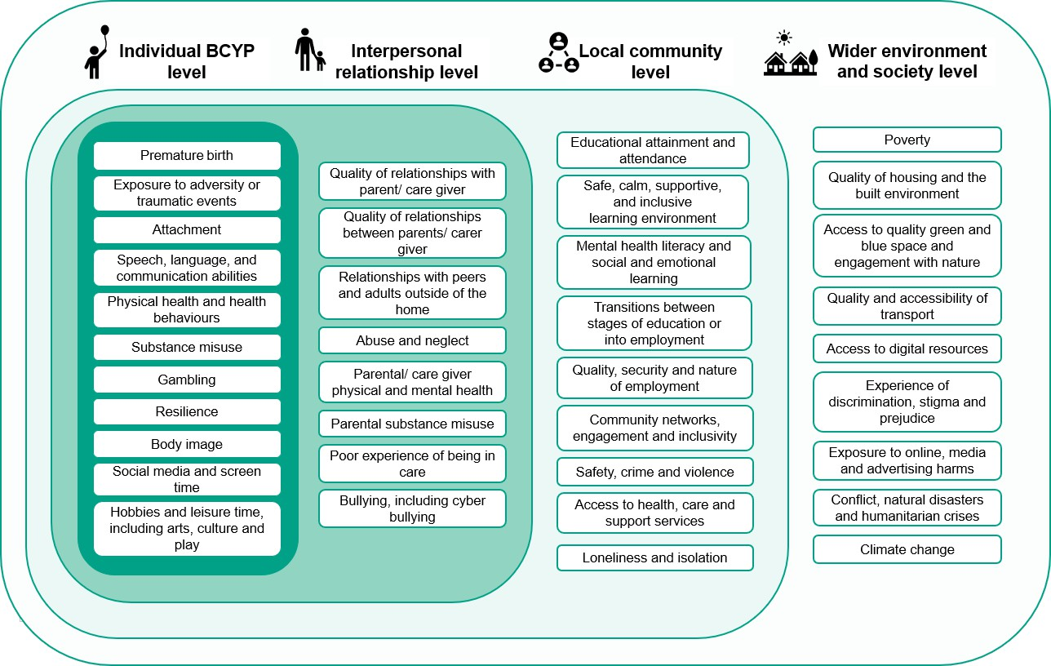
Framework
The allocation of factors into the domains was informed by a judgement about the level at which the action to modify the factor is most likely to be taken.
Some factors are cross-cutting in nature and could sit in multiple domains.
The vertical listing does not reflect a hierarchy of priorities.

Slide 10
Targeting those most at risk
Adolescents
LGBTQ+
Being in contact with social care
Parent with psychosis
Experiencing brain damage
SEND
Diverse cognitive functioning
Experience of poverty/deprivation
Experience of criminal justice system
Being an immigrant, asylum seeker
or refugee
Not in education, employment or training (NEET)
Young carers
Living in a rural area
Experience of homelessness
Characteristics that are associated with disproportionately poorer mental health outcomes and/or higher prevalence of mental health conditions
There are also disparities in outcomes according to ethnicity and gender
BUT, these are variable according to other characteristics, such as age

Slide 11
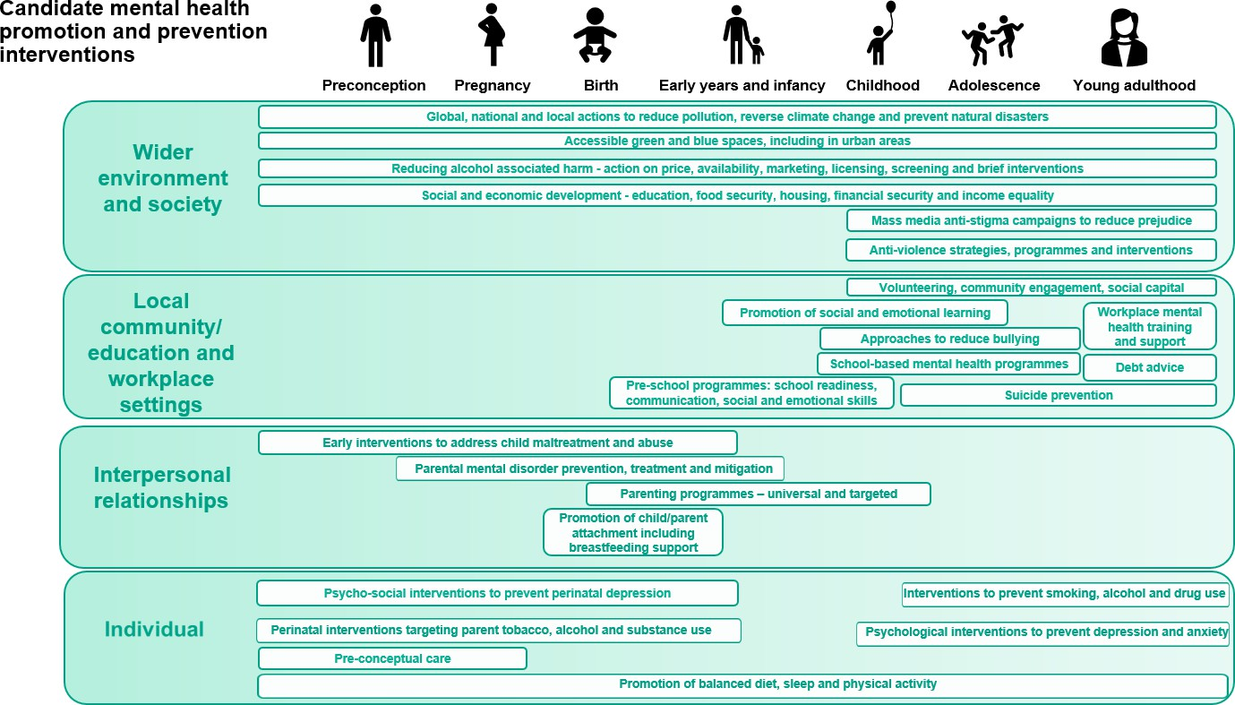
Example approaches

Slide 12




How can this information be used in practice?
Informing the scope and content of a local BCYP mental health strategies and action plans
Creating more systemic solutions to tackling underpinning and ingrained risk factors
Prompting consideration of local evidence, e.g., the views of CYP and families and wider system stakeholders
Considering which BCYP population groups should be the focus of targeted support
Considering which metrics can help to monitor and measure impact
Identifying gaps in local BCYP mental health provision and leveraging action to address these

Slide 13
Resources
Resource | Link | Resource | Link
The Framework of Modifiable Factors of the mental health and wellbeing for babies, children and young people | Link | Campaign Resources | Link
Improving the mental health of babies, children and young people: methodology, literature review and stakeholder feedback that informed the framework | Link | Parent-infant relationships: starting conversations (practitioner guide) | Link
Improving the mental health of babies, children and young people: examples of government-led contributions | Link | Reflecting on parent-infant relationships: a practitioner’s guide to starting conversations | Link
The Best Start for Life: A progress Report on Delivering the Vision | Link
The Best Start for Life: A Vision for the 1001 Critical Days | Link

Slide 14
Looking across the spectrum of mental health: NW Data Lab
Jo Sampson, Health and Wellbeing Improvement Manager, OHID NW
February 2026

Slide 15
State of the Region: mental health in the North West
The prevalence of common mental health conditions has steadily increased from 17.5% in 2000 to 22.6 in 2023/4 (depression, anxiety, panic disorders, OCD and phobias). ​
One in five adults reported a common mental health condition with variation by age and gender. Rates in the North West have stabilised and are now in line with the England average.
The rate of hospital admissions for self harm is significantly worse than the England average. In 2022-24 the suicide rate at 14 per 100,000 was significantly worse than the England average.​
Young adults remain a key group: the proportion of 16-24yr olds which a common mental health condition rose from 17.5% in 2007 to 25.8% in 2023/4. Younger adults were also more likely to report lifetime non-suicidal self-harm and to screen positive for disordered eating symptoms, PTSD and ADHD than other groups.
In North West around 4% of school pupils were identified as having social, emotional and mental health needs.
Inequalities in mental health persist, with higher prevalence in those living in areas of higher deprivation, with problem debt and not inemployment.​
Source: Office of Health Improvement and Disparities Health of the region data explorer - GOV.UK and NHS England Adult Psychiatric Morbidity Survey: Survey of Mental Health and Wellbeing, England, 2023/4

Slide 16





Some questions to think about…
What can a dedicated measure on mental health and wellbeing contribute that isn’t available elsewhere?
Where to focus – the child or the parent?
Can you make changes to the thing you are measuring? Will knowing this inform prevention or earlier intervention?
Is your data able to capture inequalities?
How can you keep sight of the things you aren’t measuring? – not everything that counts can be counted
Notes:
Many of the measures already identified relate to mental health and wellbeing – what can a dedicated measure contribute that isn’t available elsewhere?
How to respond to the relationship between child and parental mental health and wellbeing?
What is the impact of having a parent who suffers with their mental health?
Where does prevention to start for children and young people?
What about the whole family – impact on siblings and other close contacts?
If focusing on “processes” – are they ones which you have power to change?
If focusing on “outcomes” – can this be converted to inform prevention or earlier intervention?
How are you understanding inequalities in access to support?

Slide 17
Mental health and wellbeing
Everyone has mental health and it is a dynamic and often overlapping continuum from well-being to severe illness. Mental health is not a binary status. For example, a person can be coping well whilst living with a severe mental illness or experience a serious mental health crisis without a diagnosed condition.
Many interventions in public mental health with the strongest evidence base lie within CYP portfolios, including: perinatal interventions, early years interventions, parenting programmes, child adversity prevention, anti-bullying and school-based emotional and learning programmes
Maintaining wellbeing
Mental distress and low wellbeing
Common mental health disorders
Severe mental illness (community services)
Severe mental illness (inpatient services)
Highly specialised needs
Getting advice
Getting help
Getting more help
Public health and support
NHS Mental Health Services
VCSEs, Local Authorities, communities, NHS primary care

Slide 18
Measuring across the spectrum of mental health
Maintaining wellbeing
Delivery of services
Risk factors
Managing mental health conditions
Local needs
Accessing support
Support during and after crisis
Inpatient stays
Self-harm and suicidality
Parenting programmes
whole-school approaches
Youth services and trusted adults
Anti-bullying
Place based support
Community assets – sport, nature, arts, heritage, connection
Living somewhere that feels safe
Alcohol, drugs, menopause, physical ill-health, smoking, body image, debt, gambling, stress
Prevalence of mental health disorders
People under the care of a Community Mental Health Team
Waiting lists and waiting times
Support for family members of those accessing care
Inequalities in provision – poverty, exclusion and racism
Wider support
Access to housing, employment, financial support
Social prescribing
Repercussions on children and families of a parental admission
Out of area placements
Detention under Mental Health Act
Education Health and Care Plans
Presentations at crisis services
A&E attendances for self-harm or non-fatal suicide attempt
Deaths by suicide
Postvention support
Follow-up (wrap around) support for those presenting in crisis
Provision and access to bereavement support

Slide 19
Behind the data…
Charlotte
Following the birth of my son in 2012 I felt very unwell mentally. Because there was no mother and baby unit, I faced being admitted to a psychiatric ward without my baby. At that point I completely broke down and said I was going nowhere without my child.
Following this event, I started to be treated at home. Sadly, things took a turn for the worse and I began to experience hallucinations and paranoia. At one point, I was listening to a news broadcast on the radio and heard a voice say, “Charlotte, I’m talking to you. Get them men out of your house. They’re going to hurt you and your baby.”
I got up, ran to the kitchen and started to shout at my husband, saying that I wanted him out of the house because he was going to hurt me and my baby. Richard told me that the radio wasn’t even on. That it was unplugged. It was frightening stuff. Horrible.
Eventually I was diagnosed with postpartum psychosis, and went on to be treated for it at home for one and a half years. The fear of having your baby taken away is a real worry for new mothers with mental health problems, so a lot of them suffer in silence which leads to problems becoming more severe
Charlotte (Cardiff) | Maternal Mental Health Alliance
Notes:
Out of area placements – lack of services available
Eventually I was diagnosed… recording diagnoses will be ‘after the fact’
Fear of having your child taken away
What if she had an older child?

Slide 20
Behind the data…
Anthony
Anthony was being bullied at school, and one of the bullies told everyone he was gay. “I never had the chance to come out as gay to anyone because I got outed by some people at school, then it spread through my entire year. I hadn’t told anyone, but they found out I had a boyfriend at the time.”
It took a huge toll on his mental health and self-esteem: a core part of his identity was reduced to school gossip.
Feeling totally overwhelmed by his situation, he started experiencing panic attacks. When he tried to get help, he was told he would have to wait for months. The noise – from the weight of the bullies’ actions – grew louder, and the pressure kept building and building.
For most of year 10, Anthony accessed the drop in and met with a wellbeing practitioner every week. Over time he noticed that he was starting to feel less anxious and more able to cope with the challenges he was facing.
Anthony’s story | The Children's Society
Notes:
Experience at school affecting mental health
Inequality of impact for LGBTQ+ young people
The story behind a wait time – longer version of story talks of how access to non-statutory services benefitted

Slide 21
Behind the data…
Matthew
I’m 14 years old and I live with my mum, dad and little sister.
I am in Year 10 and I like school, but I find it hard to make friends because I don’t have time to do things with them. Sometimes I'm late for school because things are difficult. I don’t want to bring friends home because our house is messy and my dad is a bit unpredictable.
This is because he has a mental illness. He often sleeps during the day and my mum works all the time. She has to because Dad can’t work. I love my mum and dad but I also feel responsible for them. Mum does her best but she can’t do everything. I do most of the housework and the shopping and sometimes I do the cooking, but I am not very good at it and my sister is too little. I enjoy being helpful and grown up, but it does get me down at times.
I worry that I will have a mental illness just like my dad one day. Although my teacher told me that I won't necessarily become ill as well. I'm interested in the brain now and how it works, and I hope I find out more in the carer's group that the school has started. At least I don't feel like the odd one out anymore.
Our Time Charity - Matthew’s Story
Notes:
Impact on child
Impact on whole family – mum and little sister are here too
Longer version of the story told of a whole school approach to raise awareness of mental health and how this reduced stigma felt by Matthew
Received support and reassurance – preventative
Young carer

Slide 22
Developing Child & Parental Mental Health data for NW MASAs
This session brings together partners from across the North West to collaborate on developing a useful set of data measures and guidance regarding child and parental mental health.
We’ll explore what data is currently available, where the gaps are, and how we can strengthen our collective understanding of children’s and families lived experiences.
Share current practice – Review existing data across agencies and discuss what this tells us about need and impact.
Explore understanding – Identify what information we don’t yet capture, and what we want our data to tell us about the lived experiences of children and families.
Collaborate– Co-produce ideas to strengthen our data: agreeing shared definitions, identifying data gaps, and reflecting on why this matters to our partnership.
Session outcomes:
Identify useful data measures and accompanying definitions and guidance, supporting consistency in how child and parental mental health data is defined and understood within safeguarding partnerships regionally.
Identify opportunities for alignment with national developments and good practice, strengthening our collective approach and improving outcomes for children and families.

Slide 23
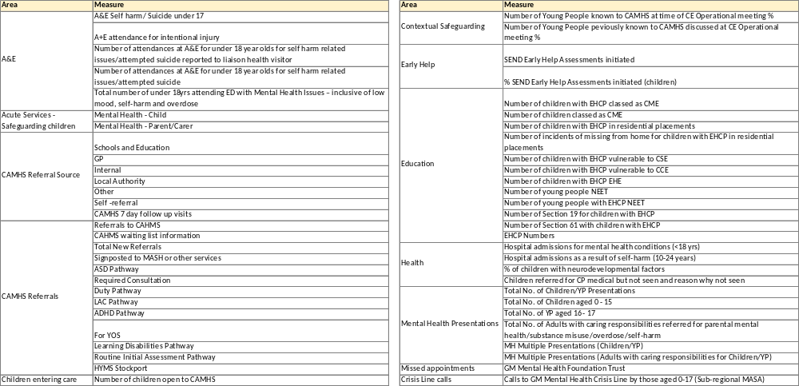
Existing data utilised by NW MASAs

Slide 24
North West Multi-agency Safeguarding Learning and Support Hub
Breakout Room Discussions

Slide 25
Break out discussion 1: Existing data and insights
What data and insights do we currently have that could help us better understand and respond to child and parental mental health?
What is the most important to focus on and why? See slides for reference - consider what we’ve heard about inter-connected factors, and the spectrum of mental health
Nominate a note taker to update the teams chat when we re-group

Slide 26
Break out discussion 2: Gaps
Where do you see gaps in data and insights to better understand and respond to child and parental mental health? See slides for reference - consider what we’ve heard about inter-connected factors, and the spectrum of mental health
What data and insights could your agency bring to your local safeguarding partnership arrangement, to help fill identified gaps?
Nominate a note taker to update the teams chat when we re-group

