Slide 1

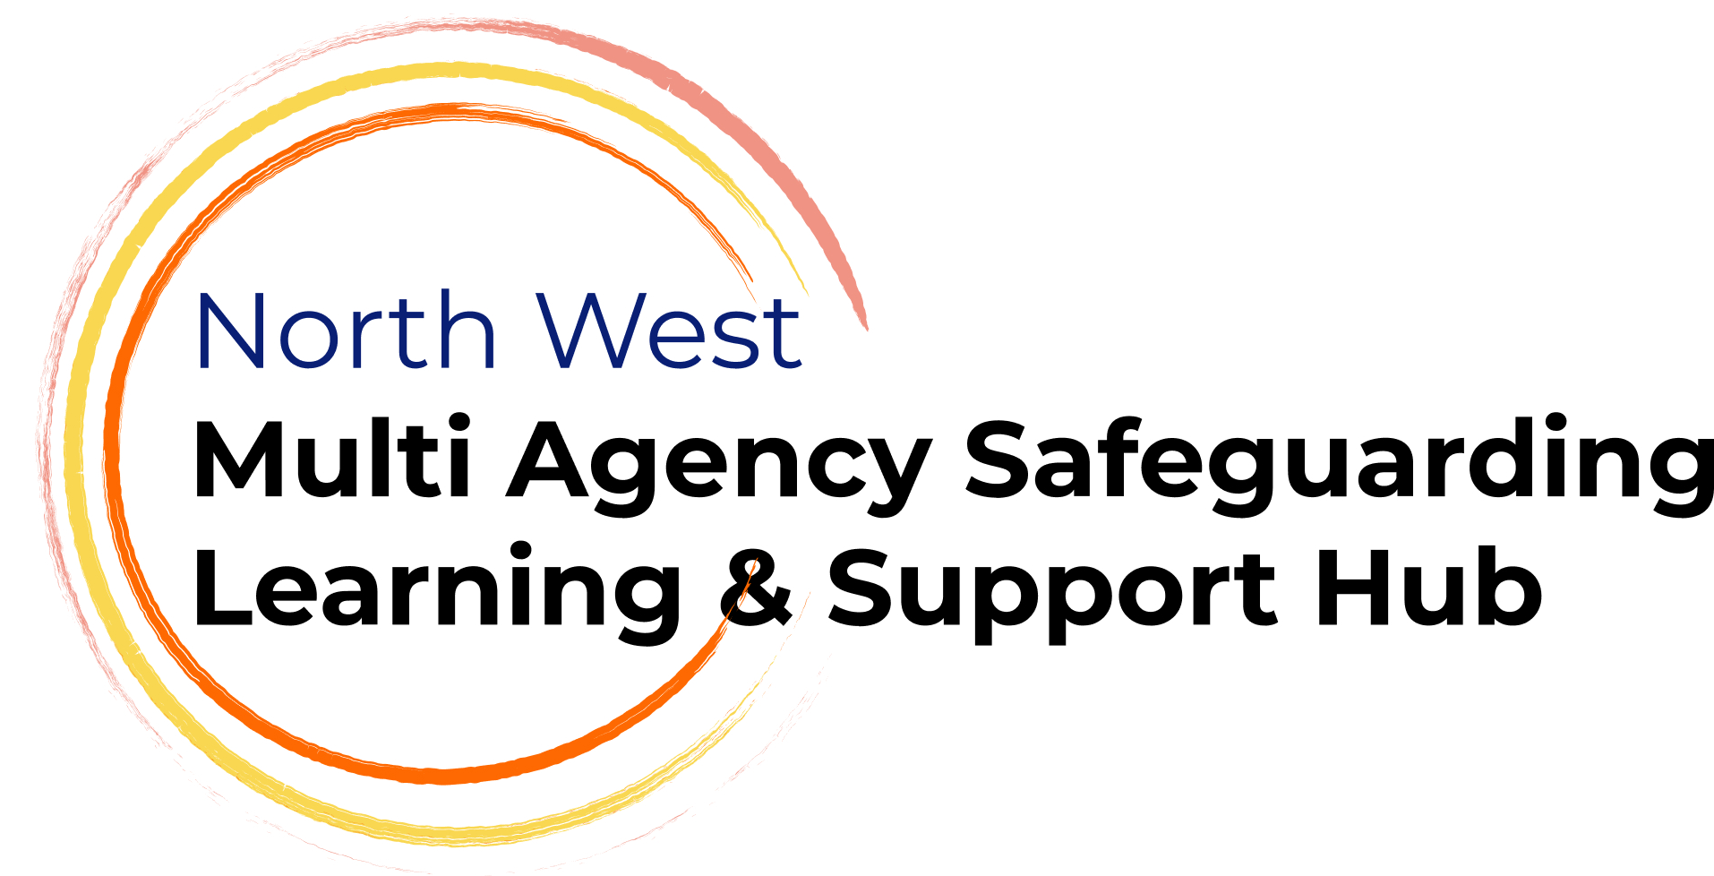


North West Learning and Support Hub
Child Exploitation Data Lab

Slide 2
Time | Item | Objective/ Outcome
1:00-1:05 | Welcome and Introduction
1:05-1:15 | North West Multi-Agency Safeguarding Dataset | Intro to the regional safeguarding dataset and related guidance documents
1:15-1:40 | Understanding Exploitation Nik Autumn, Social Work Lead, GM Complex Safeguarding Hub | Child Exploitation 101 – types of harm, intersectionality and the importance of data and analysis
1:40 | Breakout 1: Existing data | What data and insights do we have that could help us better understand and respond to child exploitation?
1:50 | Group feedback
2:05 | Breakout 2: Gaps | Where do you see gaps in data and insights to better understand and respond to child exploitation? What data and insights could your agency bring to your local safeguarding partnership arrangement, to help fill identified gaps?
2:15 | Group feedback
2:30 | Breakout 3: Impact and Outcomes | What areas should we focus on to understand impact and outcomes? How can we develop data and insights to better capture impact and outcomes for children and families?
2:40 | Group feedback
2:55 | Next Steps and Feedback question

Slide 3
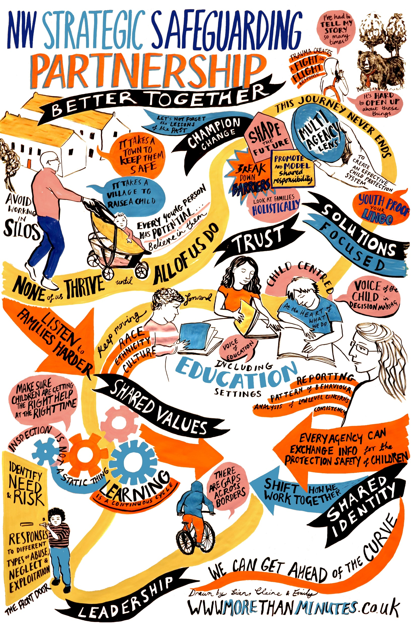
NW Safeguarding Partnership
North West Children's Safeguarding Partnership MoU | NWADCS
Leading new and innovative approaches in the North West Pilot
Committing to:
Sharing what's working for our children and families
Enabling the sharing to be adopted and build upon in our systems
Collaborating on common challenges/needs, avoid duplication
Examples of outcomes and impact:
NW Multi agency data set
Sub regional and regional safeguarding effectiveness reporting
Child Sexual Abuse NW strategy (4300 participants)
Co production of thresholds tools with children and families
Scoping for system to share NW learning and resources from practice reviews

Slide 4
As identified in the national panel research, we need greater connection as system leaders to create the environment for real learning and change.
The North West Safeguarding Effectiveness Framework strengthens local, regional, and national safeguarding through multi agency safeguarding partnerships, systems leadership, and accountability.
DSP & LSP
National Panel, Child Protection Authority National Safeguarding and Policy Leads
North West Safeguarding Effectiveness Analysis
Sub-regional Safeguarding Effectiveness Analysis
(Lancashire / Cumbria / Cheshire / Merseyside / Greater Manchester)
Local MASA Safeguarding Effectiveness Analysis
Notes:
research-Learning support and capability project

Slide 5
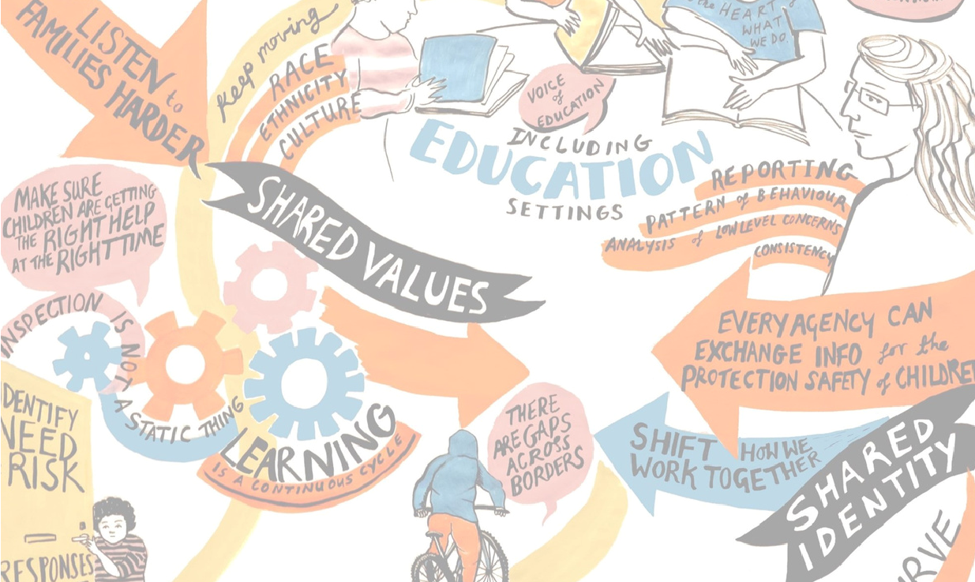
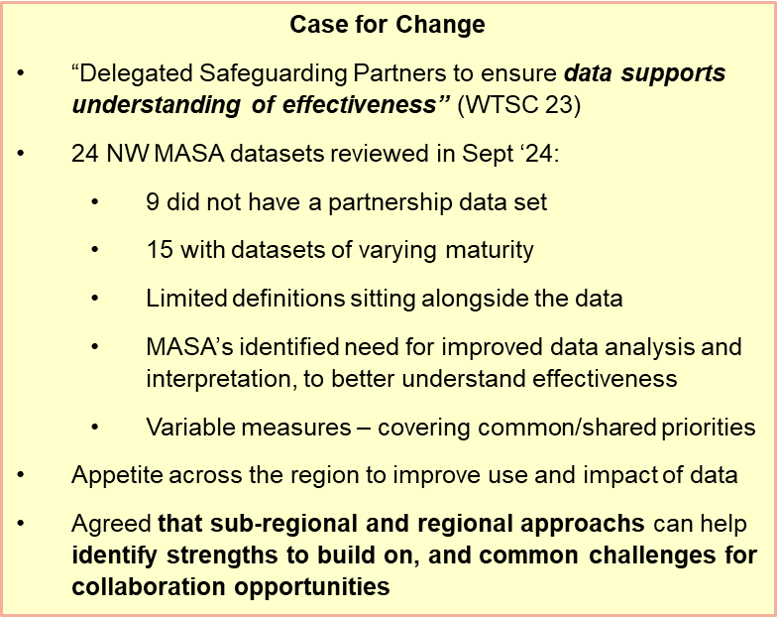
North West Multi-agency Safeguarding Data – Our journey so far
Sept 2024 Sept 2025 Dec 2025 2026
Consultation and design
Develop the dataset and the narrative
Data set extended for Q2
Mature and improve
Initial collection and development
Data Tool > Dashboard development
Regional ‘Interpreting Data’ session to develop multi-agency narrative and data discussions
Single-agency development sessions
6 additional Police measures – returned by all 5 NW police forces ☺
Data labs on key priority themes to develop datasets (Mental Health and DVA)
CSA Outcomes Framework developed
Initial NW Multi-Agency Safeguarding dataset proposed
Data labs on key priority themes to develop datasets and outcome frameworks (Neglect and Exploitation)
Extensive multi-agency consultation
Definitions and Guidance documents circulated
Quarterly returns for:
Q4 - 01/05/26
Develop further measures – health, housing
Q3 - 06/02/26
Initial data collection (Q1) 19 of 24 areas returned ☺

Slide 6
Sub regional overarching analysis of public health, deprivation, demand on systems to scene set
Commitment 1
Children’s needs are identified early and effectively responded to
Commitment 2
Children are protected from risk of harm
Commitment 3
Children are effectively safeguarded, and their welfare promoted
Commitment 4
Multi-agency partners work together and hold each
other to account
Contacts by agency
Early Help lead professionals by agency
Early Help numbers (Family Help)
Number of children awaiting specialist health assessments/provision (CAMHs)
Child in Need numbers (Family Help)
Referrals by agency
Repeat referrals
Conversion rate contacts to referrals
Strategy meetings/S47/ICPC
Educational Attendance, Exclusions, Electively Home Educated & NEET
Repeat missing from home incidents
CSA and CSE offences
Neglect offences
Child Stop Searches
Child Arrests
Child Strip Searches
Use of Police Powers of Protection
Number of children subject of Child Protection Plans
Repeat CP in two years
Family Group Decision Making offered and held
Number of children subject to Public Law Outline
Initial Health Assessment timeliness
Referrals for practice reviews, serious incident notifications and referring agency
Multi-agency attendance at executive meetings (including education as a strategic partner)
Measure now:
Measure now:
Measure now:
Measure now:
Develop:
Develop:
Develop:
Develop:
Family help plans (care reforms)
Family help needs measures
Mental Health (Child/Parental)
  Extra Familial Harm (CCE/CSE/Online Harm)
  Domestic Abuse
  Neglect
  Serious Youth Violence
Multi-agency child protection team data
How we understand belonging for children
Training delivered
Children seen by partners
Child and parental influence tracker
Voice and experience of children and families- belonging, loving homes and thriving families

Slide 7

Understanding Exploitation
Nik Autumn
GM Complex Safeguarding Hub
Greater Manchester Combined Authority

Slide 8
Content
Understanding child exploitation and emerging trends
Considering intersectionality in the context of exploitation
Findings from peer reviews
Understanding trauma, toxic stress, and impact on behaviour
Knowing the signs/indicators of exploitation, and their limits

Slide 9



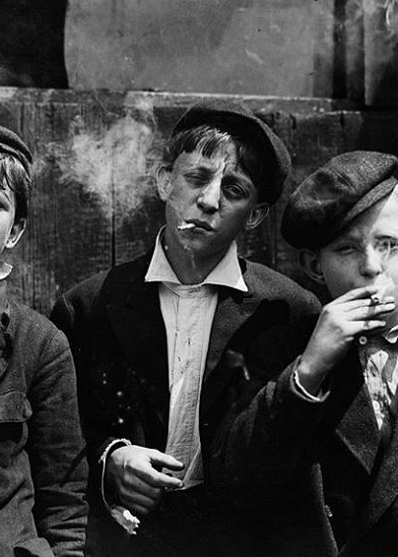

History
It didn’t start in Rochdale…

Slide 10
Modern Slavery
Modern slavery involves the exploitation of people for personal or commercial gain, often through coercion, deception, or abuse of vulnerability. Common forms include:
Forced Labour
Individuals are compelled to work under threat or coercion, often in poor conditions and for little or no pay.
Sexual Exploitation
Adults are forced into prostitution or other sexual activities through violence, threats, or manipulation.
Criminal Exploitation
Victims are coerced into committing crimes such as drug trafficking, theft, or fraud.
Domestic Servitude
People are forced to work in private households, often isolated and without freedom of movement.
Notes:
The term “modern slavery” is used today to describe a range of exploitative practices, including forced labour, human trafficking, and sexual exploitation, where people are controlled and coerced for the benefit of others. This differs significantly from transatlantic or chattel slavery, in which enslaved people were legally treated as property, bought and sold, and denied all personal rights under state and colonial laws. While chattel slavery was formally abolished in the 19th century, the underlying systems of exploitation never truly ended — forms of forced labour and human commodification have persisted throughout history and continue today. Scholars and activists note, however, that the term “modern slavery” can be problematic: it risks oversimplifying historical differences, as contemporary abuses, while severe and coercive, do not mirror the legal, racialized, and intergenerational structures of transatlantic slavery. Using the term requires careful attention to context, acknowledging both the continuity of exploitation and the distinct historical experiences of chattel slavery.

Slide 11
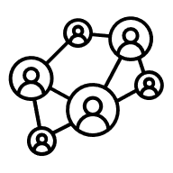
Exploitation of Children
Immigration Fraud
Cannabis Cultivation
CSE
Sextortion
CCE
Money Laundering
Forced Labour
County Lines
Serious Violence
Shoplifting
Radicalisation
Domestic Servitude
Benefit Fraud
Financial Crime
Organ Harvesting

Slide 12
Child Sexual and Criminal Exploitation
CSE is a form of child sexual abuse.
It occurs where an individual or group takes advantage of an imbalance of power to coerce, manipulate or deceive a child or young person under the age of 18 into sexual activity (a)
in exchange for something the victim needs or wants, and/or (b) for the financial advantage or increased status of the perpetrator or facilitator. The victim may have been sexually exploited even if the sexual activity appears consensual.
Child sexual exploitation does not always involve physical contact; it can also occur through technology.
(Department for Education, 2017)
CCE occurs where an individual or group takes advantage of an imbalance of power to coerce, control, manipulate or deceive a child or young person under the age of 18. The victim may have been criminally exploited even if the activity appears consensual.
Child criminal exploitation does not always involve physical contact; it can also occur through using technology.”
(Serious Violence Strategy, 2018)
County Lines is where illegal drugs are transported from one area to another, often across police and local authority boundaries, usually by children or vulnerable people who are coerced into it by gangs.
Criminalisation
Notes:
Discuss overlap and how both involve criminalisation, sexual violence and isolation

Slide 13



Child Exploitation: Emerging Trends
Rise in online exploitation and abuse, including sextortion, grooming on gaming platforms, money laundering, AI-generated sexual imagery and deepfakes.
Exploitation of young people in schools to sell illegal/unregulated vapes.
New forms of “rewards”, more difficult to identify, such as in-game currency, gift cards, cosmetic procedures such as lip fillers and nails.

Slide 14

Intersectionality
Multiple identities, multiple risks Age, gender, ethnicity, disability, and social circumstances can overlap to increase vulnerability.
Hidden experiences Some harms are less visible unless we consider intersecting factors.
Bias and barriers Understanding intersectionality helps challenge assumptions and ensure fair access to support.
Effective safeguarding Strategies that recognise diversity are more inclusive, equitable, and impactful.
Racially minoritised and neuro-diverse children are overrepresented

Slide 15
Adolescent Abuse and Neglect
Extra‑familial harm is an important focus of complex safeguarding — but it’s not always that simple.
Whilst any child can be targeted for exploitation, for many the reality is a complex web of inter‑familial and extra‑familial harm. Our peer reviews show that neglect and domestic violence are present in almost all case audits, pointing to how harm within families often co‑exists with risks outside the home.
Research demonstrates that poverty and material hardship are key drivers of abuse, neglect and exploitation with deeper levels of poverty linked to higher rates of harm.
Deprivation can mask harm Practitioners may normalise poverty as “just how things are,” without recognising the associated risk and vulnerability it creates.
Neglect
Lack of supervision and guidance
Emotional and Psychological Impact
Social Isolation
Unmet Basic Needs
Substance Abuse
Educational Neglect
Legal Implications

Slide 16
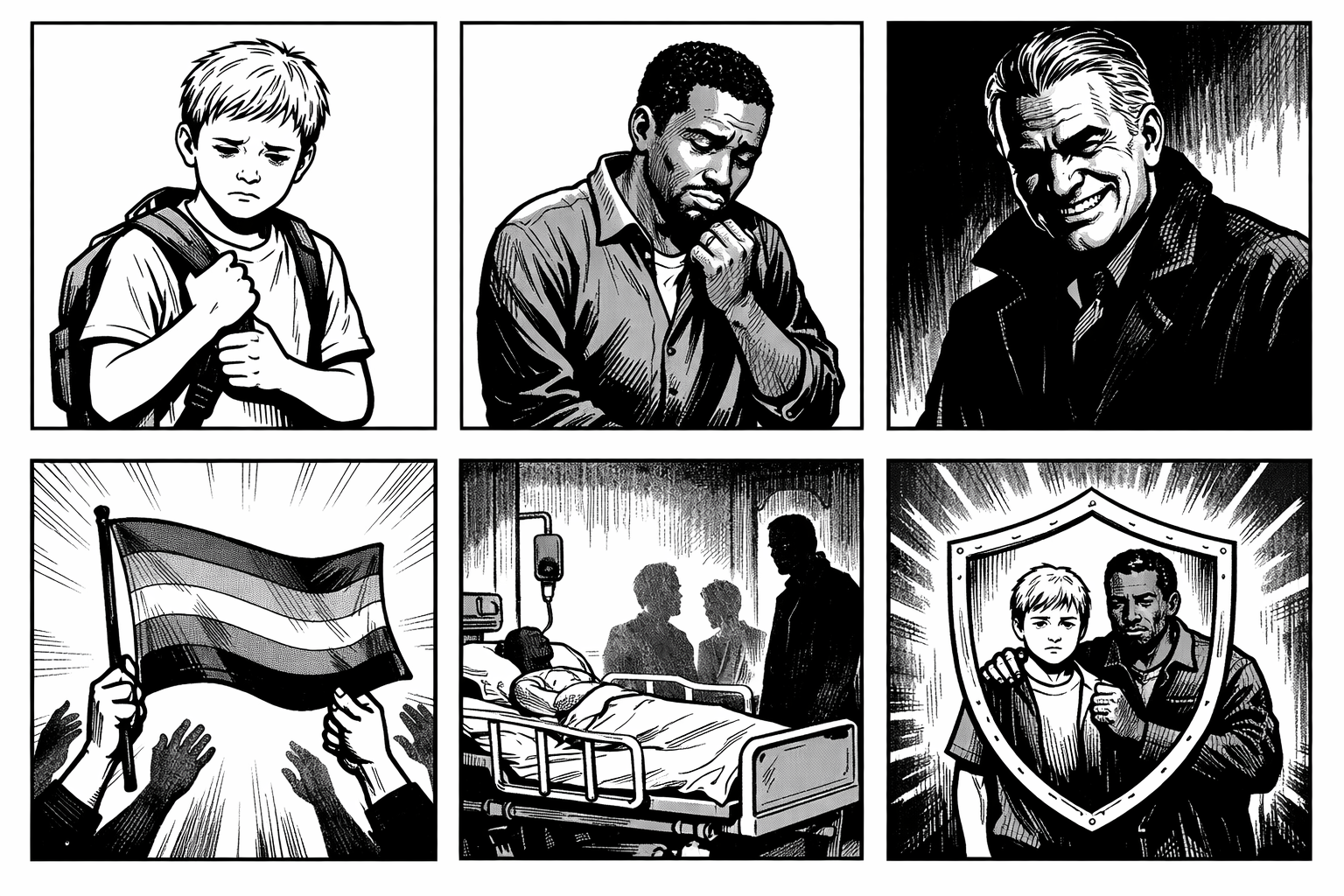
Ethan’s Story
Notes:
1 Ethan is a looked after child, CCE referral due to missing episodes, cigarettes and association with a ‘black male’
2 John is a vulnerable adult in his 20s with learning disabilities linked to an address of a 60-year-old white British male
3 60-year-old white British male, police intelligence that his twin brother is on the sex offenders register
4 Intelligence via Crimestoppers from LGBT community, concern for white British male’s behaviour towards young male sex workers and younger males in general
5 NHS records show he was attempting to groom a young male in hospital
6 Identified as CSE, Ethan and John safeguarded, offender prevented from harming Ethan

Slide 17


How do we identify exploitation?
Obvious indicators (“red flags”):
Repeated missing episodes or going missing from home or care
Signs of physical harm, injury, or self-harm
Mental health concerns, including anxiety, depression, or trauma responses
Sudden changes in behaviour, school attendance, or friendships
Subtle indicators (“absence of normality”):
Victims may avoid mainstream services due to control, fear, or manipulation
Fragmented access to healthcare: attending walk-in centres instead of GPs, or visiting multiple sexual health clinics rather than one familiar service
Isolation from peers or usual activities, which may be enforced by exploiters
Difficulty forming trusting relationships with professionals, reflecting high levels of coercion or manipulation

Slide 18
Any Questions

Slide 19
Developing Exploitation data for NW MASAs
This session brings together partners from across the North West to collaborate on developing a child exploitation data set and guidance on what we want it to tell us!
We’ll explore what data is currently available, where the gaps are, and how we can strengthen our collective understanding of children’s and families’ lived experiences.
Share current practice – Review existing data across agencies and discuss what this tells us about need and impact.
Explore understanding – Identify what information we don’t yet capture, and what we want our data to tell us about the lived experiences of children and families.
Collaborate– Co-produce ideas to strengthen our data: agreeing shared definitions, identifying data gaps, and reflecting on why this matters to our partnership.
Session outcomes:
Start the co-production of a regional data set and accompanying guidance, supporting consistency in how child exploitation is defined, recorded, and understood across agencies.
Identify opportunities for alignment with national developments and good practice, strengthening our collective approach and improving outcomes for children and families.

Slide 20
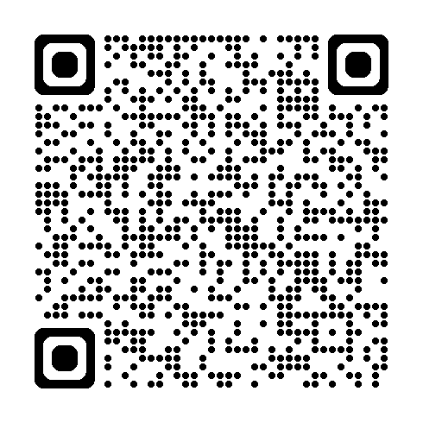
Menti 1: What are the key factors influencing child exploitation in your area?
Notes:
https://www.menti.com/alrdu2iv1bi3

Slide 21
Definitions !
Lots of different terminology in the North West, we have:
  Extra Familial Harm (EFH)
  Harm outside the Home (HOTH)
  Complex Safeguarding
  Risk outside the Home (ROTH)
  Contextual Safeguarding
Differentiate between the type of harm, and the response/pathway/approach.
Essentially though, all about Child Exploitation as a priority area for 16 of 24 MASA’s, the source and context of that harm is often complex and nuanced. In most areas the focus is around CSE, CCE, Modern slavery and Trafficking.
Links to many other priority thematic areas - serious violence, organised crime, domestic abuse and neglect.

Slide 22
North West Multi-agency Safeguarding Learning and Support Hub
Breakout Room Discussions

Slide 23
Break out discussion 1: Existing data and insights
What data and insights do we currently have that could help us better understand and respond to child exploitation?
What is the most important to focus on and why?

Slide 24
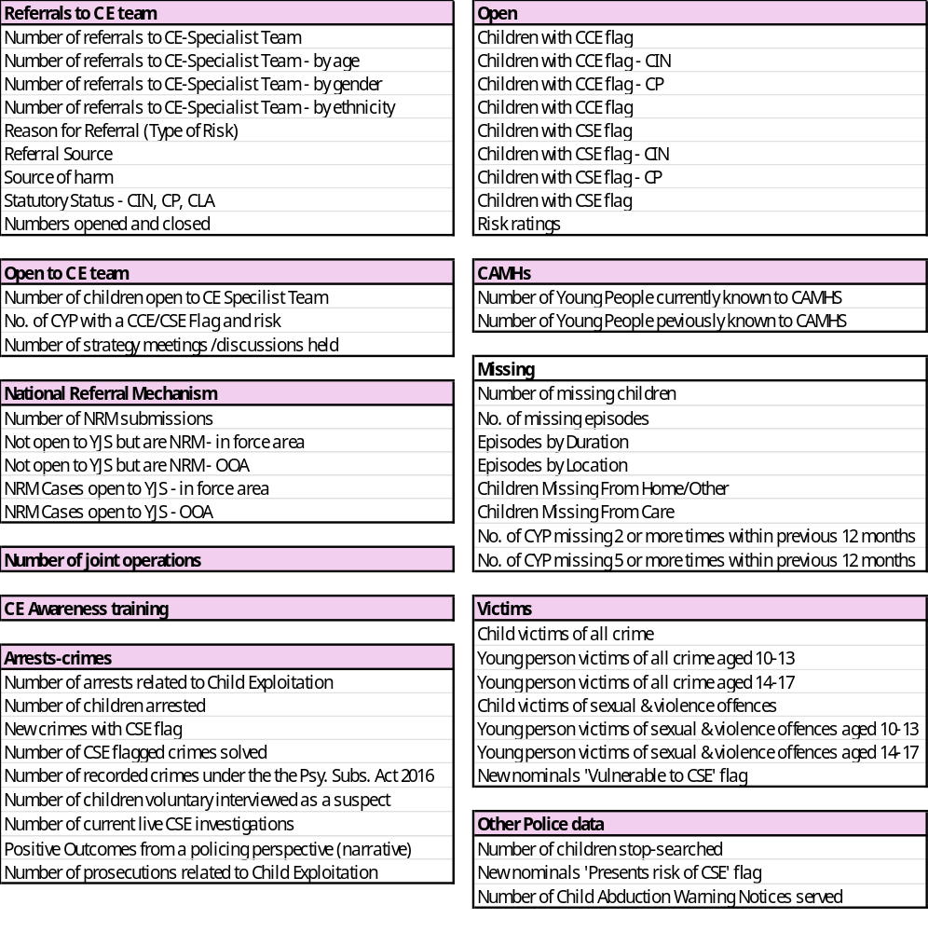
Child Exploitation data - NW
Hub has identified that Child Exploitation (in those various forms) is a priority for 16 of 24 NW MASAs and a key area for data development
Currently around 71 similar measures - summarised into the 55 listed here
Notes:
If you have anything different- please add into the chat now please

Slide 25
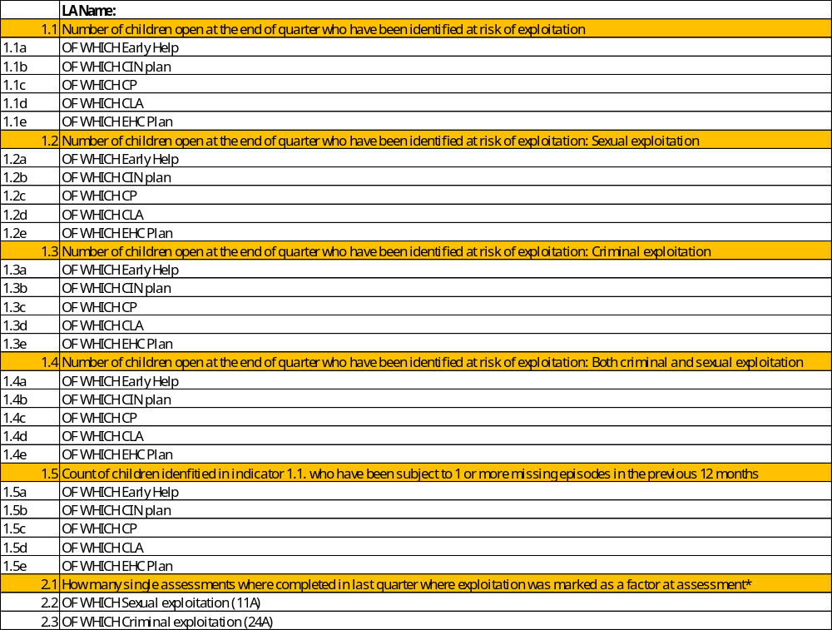
What might a focus area look like at a regional level?
At a regional level, one idea would be to pick a key metric to understand the scale of need. The work below comes from a piece of work the NW RIG undertook in 2023-24 (focus of JTAI data provision):

Slide 26
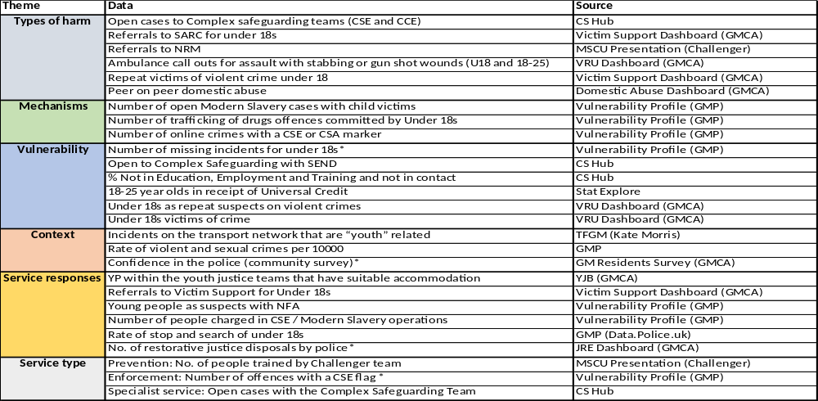
Adolescent Harm example
Dataset list below is a sub-regional example from GM – combining a snapshot of adolescent harm related data on different themes, captured in different single and multi-agency forums.

Slide 27
Break out discussion 2: Gaps
Where do you see gaps in data and insights to better understand and respond to child exploitation?
What data and insights could your agency bring to your local safeguarding partnership arrangement, to help fill identified gaps?

Slide 28
Break out discussion 3: Impact and Outcomes
What areas should we focus on to understand impact and outcomes?
How can we develop data and insights to better capture impact and outcomes for children and families?

Slide 29
Next Steps
Circulate an Exploitation Outcomes Framework, with definitions and guidance

Slide 30
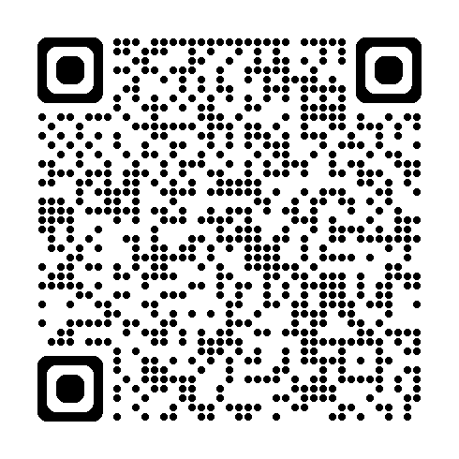
Menti 2: What will you take away from todays session?
Notes:
https://www.menti.com/alrdu2iv1bi3

