Slide 1




North West Learning and Support Hub
Neglect Data Lab

Slide 2

NW Safeguarding Partnership
North West Children's Safeguarding Partnership MoU | NWADCS
Leading new and innovative approaches in the North West Pilot
Committing to:
Sharing what's working for our children and families
Enabling the sharing to be adopted and build upon in our systems
Collaborating on common challenges/needs, avoid duplication
Examples of outcomes and impact:
NW Multi agency data set
Sub regional and regional safeguarding effectiveness reporting
Child Sexual Abuse NW strategy (4300 participants)
Co production of thresholds tools with children and families
Scoping for system to share NW learning and resources from practice reviews

Slide 3
As identified in the national panel research, we need greater connection as system leaders to create the environment for real learning and change. The North West Safeguarding Effectiveness Framework strengthens local, regional, and national safeguarding through multi agency safeguarding partnerships, systems leadership, and accountability.
DSP & LSP
National Panel, Child Protection Authority National Safeguarding and Policy Leads
North West Safeguarding Effectiveness Analysis
Sub-regional Safeguarding Effectiveness Analysis
(Lancashire / Cumbria / Cheshire / Merseyside / Greater Manchester)
Local MASA Safeguarding Effectiveness Analysis
Notes:
research-Learning support and capability project

Slide 4
Desired Impact for out Children and Families
National Government
Regional
Improved services and outcomes are led by children, family and community voice and experiences
Strong local approaches to multi-agency safeguarding effectiveness.
Increased understanding of system strengths, barriers and challenges that can be understood and addressed sub-regionally and regionally.
A NW voice to advocate where national support, enabling and change is required.
Sub regional
Macro
MASAs- Delegated and Lead Safeguarding Leads
Meso
Local Government
Strategic Leaders and Managers
Micro
Practitioners
Babies, Children and Families

Slide 5
NW Multi Agency Safeguarding Effectiveness Journey travelled

Slide 6
NW Multi Agency Safeguarding Effectiveness Data: Case for change
Delegated Safeguarding Partners to ensure data supports understanding of effectiveness (WTSC 23)
24 Multi Agency Safeguarding Arrangements (MASA) in the NW
Datasets reviewed in September 2024:
  9 did not have a partnership data set
  15 maturity and impact of the data set was variable
  Limited definitions sitting alongside the data
  Largely Local Authority data
  Variable or no multi agency analysis being presented to understand safeguarding effectiveness
  Variable data points being used, with clear commonality on themes
Desire from all MASAs to get data working better for them, as part of the effectiveness framework
Sub regional and regional approaches can help identify strengths to build on and common challenges to collaborate better together

Slide 7
Journey so far
Consultation 2024
Developing the case for change
Initial core NW Multi-Agency Data Set Agreed
Q1 Data Collection and single agency data discussion
Updating core dataset for Q2 and developing priority themes

Slide 8
Dataset design
Following a series of Deep Dives, a dataset has been designed that would be:
Achievable by the majority of NW MASAs: leveraging on what's already being reported in the system
Designed around a set of commitments drawing together all the requirements in statutory guidance
Focused on those areas of practice where multi-agency working is prioritised
Understanding that differing geographies have different requirements
Regional
Regional working to promote best practice, provide guidance on upcoming legislation, develop regional needs assessment, data and aligned priorities
Sub-regional
Sub-regions working to understand and coordinate data sharing at scale. There are indications from the current Government that sub-regional working (i.e. at CA level) will be rolled out nationally and become increasingly important.
MASA level
MASAs should have a needs assessment with demographic info, data collected on local priorities, strong systemic documentation etc.
Single Agency
Single Agencies have their own performance frameworks and governance reporting.
Regular narrative reporting to MASAs provide transparency and assurance.

Slide 9
Mapping the NW LSCP Response
National Framework Outcome
Working Together Principle
National Framework Enabler
Commitment 1
Children’s needs are identified early and effectively responded to
Commitment 2
Children are protected from risk of harm
Commitment 3
Children are effectively safeguarded, and their welfare promoted
Commitment 4
Multi-agency partners work together and hold each other to account
Enabler 1
Multi-agency workforce is stable and appropriately equipped
Enabler 2
Learning is promoted and embedded to implement changes to practice
Understanding our local area
Children and young people are safe in and outside of their homes
Whole system support for children and families
Skilled Workforce
Children, young people and families stay together and get the help they need
Culture of accountability
Multi-agency working is prioritised and effective
Leaders drive conditions for effective practice
The workforce is equipped and effective
Children and young people are supported by their family network
Children in care and care leavers have stable, loving homes
Outcomes for children and families
Using data for understanding and prevention
Effective Safeguarding
Listening to children and families

Slide 10
Sub regional overarching analysis of public health, deprivation, demand on systems to scene set
Commitment 1
Children’s needs are identified early and effectively responded to
Commitment 2
Children are protected from risk of harm
Commitment 3
Children are effectively safeguarded, and their welfare promoted
Commitment 4
Multi-agency partners work together and hold each
other to account
Contacts by agency
Early Help lead professionals by agency
Early Help numbers (Family Help)
Number of children awaiting specialist health assessments/provision (CAMHs)
Child in Need numbers (Family Help)
Referrals by agency
Repeat referrals
Conversion rate contacts to referrals
Strategy meetings/S47/ICPC
Educational Attendance, Exclusions, Electively Home Educated and NEET
Repeat missing from home incidents
Use of Police Powers of Protection
Number of children subject of Child Protection Plans
Repeat CP in two years
Family Group Decision Making offered and held
Number of children subject to Public Law Outline
Initial Health Assessment timeliness
Referrals for practice reviews, serious incident notifications and referring agency
Multi-agency attendance at executive meetings (including education as a strategic partner)
Measure now:
Measure now:
Measure now:
Measure now:
Family help plans (care reforms)
Family help needs measures
Mental Health (Child/Parental)
Multi-agency child protection team data
How we understand belonging for children
Develop:
Develop:
Training delivered
Children seen by partners
Child and parental influence tracker
  Extra Familial Harm (CCE/CSE/Online Harm)
  Neglect
  Domestic Abuse
  Child Sexual Abuse
  Serious Youth Violence
Develop:
Develop:
Voice and experience of children and families- belonging, loving homes and thriving families

Slide 11
DEEP DIVEs now planned!
Aligned with themed priorities

Slide 12
Developing Neglect data for NW MASAs
This session brings together partners from across the North West to collaborate on developing a neglect data set and guidance on what we want it to tell us!
We’ll explore what data is currently available, where the gaps are, and how we can strengthen our collective understanding of children’s and families’ lived experiences of neglect and families first practice.
Share current practice – Review existing neglect data across agencies and discuss what this tells us about need and impact.
Explore understanding – Identify what information we don’t yet capture, and what we want our data to tell us about the lived experiences of children and families.
Collaborate– Co-produce ideas to strengthen our data: agreeing shared definitions, identifying data gaps, and reflecting on why this matters to our partnership.
Session outcomes:
Start the Co-production of a regional Neglect Data Tool and accompanying guidance, supporting consistency in how neglect is defined, recorded, and understood across agencies.
Identify opportunities for alignment with national developments and good practice, strengthening our collective approach and improving outcomes for children and families.

Slide 13
Definition of Neglect (NSPCC)
Neglect is the ongoing failure to meet a child's basic needs and the most common form of child abuse. A child might be left hungry or dirty, or without proper clothing, shelter, supervision or health care.
This can put children and young people in danger.
And it can also have long term effects on their physical and mental wellbeing.
Types of neglect
Physical neglect
Educational neglect
Emotional neglect
Medical neglect

Slide 14

Notes:
https://www.menti.com/alrdu2iv1bi3

Slide 15
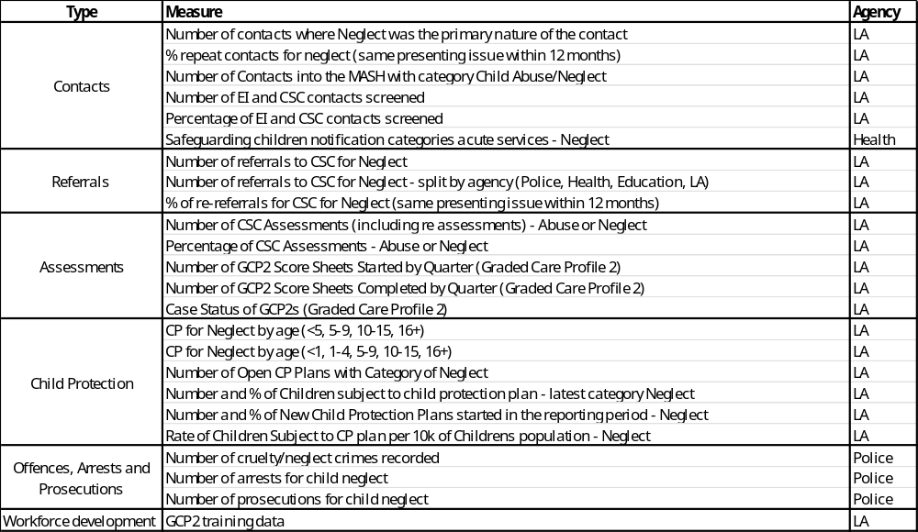
Neglect data in the NW
Hub has identified that Neglect is a priority for 14 of 24 NW MASAs and a key area for data development – with 32 similar measures summarised into the 24 below
Notes:
If you have anything different- please add into the chat now please

Slide 16
Multi Agency data interpretation- what does it mean for OUR children?
Performance indicators are a guide when providing information for analysis and to support discussion they are not an exhaustive list and anything of relevance within the theme should be highlighted if an agency feels it is important to share
Indicators may not be within every agencies data set, but every agency is likely to have some knowledge to share, think tank is about quantitative and qualitative multi-agency input
All of the Themes/Indicators are everyone’s business “Think Collectively”

Slide 17
North West Multi-agency Safeguarding Learning and Support Hub
Neglect Data Lab Breakout Room Discussions

Slide 18
Families First Care Reforms:
Children, young people and families stay together and get the help they need
Children and young people are supported by their family network
Break out discussion 1:
Prevention
What data and insights could help us identify patterns or pressures (e.g. poverty, housing, school attendance, parental stress) that signal the need for earlier support?

Slide 19
Families First Care Reforms:
Children, young people and families stay together and get the help they need
Children and young people are supported by their family network
Break out discussion 2:
Response
Where do you see gaps in data and insights to better understand neglect and the impact of early intervention and safeguarding plans?
What data and insights could your agency bring to your local safeguarding partnership arrangement, to help identify and understand neglect and partnership working in response to this?

Slide 20
Families First Care Reforms:
Children, young people and families stay together and get the help they need
Children and young people are supported by their family network
Break out discussion 3:
Cumulative harm
How can we develop data and insights to better capture cumulative harm — where multiple lower-level concerns across services build up over time?

Slide 21
 | Medical | Nutritional | Emotional | Education | Physical | Lack of Supervision
INFANCY- 0-2 YEARS | Includes failure to notice that baby is unwell. Failure to seek medical treatment. Not attending routine health screening appointments. | Under nourishment leads to restricted growth and brain development. Link between neglect and obesity (eg if parents use sweets as pacifiers) | Infant attachments are damaged by neglect which makes learning skills more difficult. | Early language development may be affected as certain parts of the brain are dependent on stimulation to develop. | Poor home conditions may affect infant immune system. Lack of changing and nappy rash. Lack of encouragement leading to delay in skills. | Babies should be supervised at all times, especially when on surfaces or in the bath. If babies feel abandoned this can affect attachments
Notes:
NICK

Slide 22
 | Medical | Nutritional | Emotional | Education | Physical | Lack of Supervision
PRE SCHOOL- 2-4 YEARS | May include missed health and dental appointments. Failure to seek medical attention following accidents or for routine conditions such as headlice. | Not eating 1200-1500 calories per day and/ or unregulated amounts of fats or sugar in the diet- leading to heart problems, obesity and tooth decay. | Neglected children without a secure attachment may experience difficulties playing with their peers, sharing feelings, coping with frustration/ developing empathy. | Neglect can be a significant factor in delaying child’s language development eg through the amount of quality time with carers. Delay may affect education. | Child may present as malnourished, and living conditions may be poor. Child may not be toilet trained, sleeping sufficiently or have adequate boundaries. | Home may lack safety e.g stair gates, dangerous items such as drugs or knives may be within reach, child may not have appropriate car seat. Child may be left home alone.
Notes:
NICK

Slide 23
 | Medical | Nutritional | Emotional | Education | Physical | Lack of Supervision
PRIMARY- 5-11 YEARS | Children may have more infections and illnesses than their peers due to poor treatment, or lack of prevention e.g through hand washing, good diet or adequate sleep. | Food isn’t consistently provided, leading to unregulated diets of biscuits and sweets. Concerns should not just focus on weight. Children of normal weight could still have unhealthy diets. | Insecure attachment styles can lead to children having difficulties forming relationships and may express their frustration at not having friends through disruptive behaviour. | Neglected children can experience a number of disadvantages at school, including low educational aspirations, lack of encouragement for learning. | Ill fitting, inadequate or dirty clothing, poor personal hygiene, lack of sleep, lack of routines or boundaries which can lead to frustration with school routines and boundaries. | Primary school children may be left home alone after school or expected to supervise younger children. They may be left to play outside alone or to cook meals without supervision.
Notes:
NICK

Slide 24
 | Medical | Nutritional | Emotional | Education | Physical | Lack of Supervision
Adolescent 12+ years | Poor self esteem and recklessness can lead to ignoring or enduring health problems rather than accessing services. May be risk taking behaviours. | Adolescents may be able to find food but lack nutritious food and limited cooking experience can lead them to unhealthy snacks, which affects health and educational outcomes. | Peer groups and independence are important at this age. Young people who are isolated through neglect will struggle. Conflict with carers may increase. | Likely to experience cognitive impairment e.g. managing emotion, challenging behaviour in school. Low confidence and academic failure can reinforce negative self image. | Adolescents' social development is likely to be affected by their living conditions, inadequate clothing, poor hygiene and body odour. This can affect self esteem. | Neglected adolescents may stay out all night with carers not aware of their whereabouts, which can lead to opportunities for risk taking behaviours than can result in serious injury.
Notes:
NICK

Slide 25
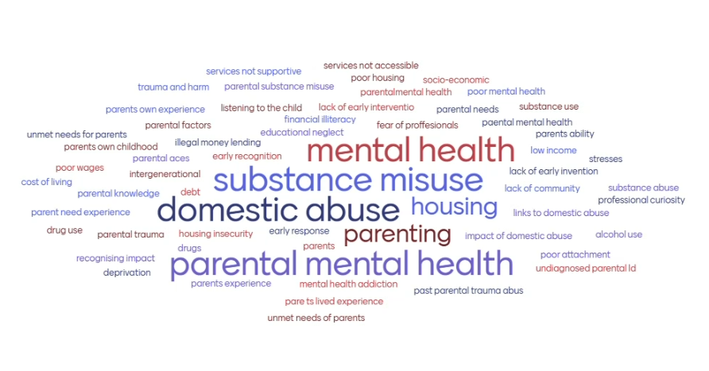

Slide 26
Next Steps
Neglect data set with guidance
Data interpreting guide and further training
Engagement with national poverty strategy leads
Regional practice learning weeks

Slide 27
Notes:
https://www.menti.com/alrdu2iv1bi3

